Slide 1

AF2903 Road Construction and Maintenance
Compaction of Hot Mix Asphalt
Dr. Alvaro Guarin
Highway and Railway Engineering
Department of Transportation Science

Slide 2
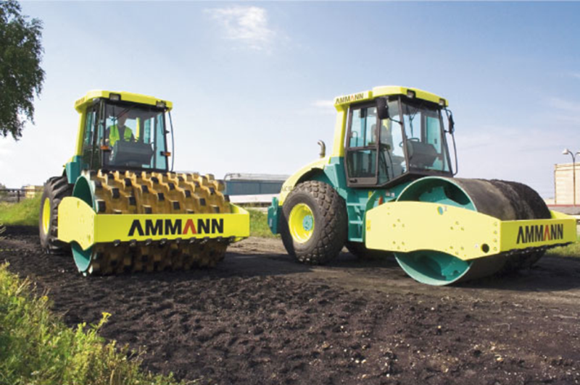
Compaction of Soils/Granular Materials

Slide 3
Compaction of Asphalt Mixtures
To Minimize Additional Compaction
To Minimize Permeability
To Prevent Excessive Oxidation of the Asphalt Mixture
To Provide Adequate Shear Strength
Three Phases of Rolling
Breakdown Rolling
Intermediate Rolling
Finish Rolling

Slide 4
Breakdown Rolling
Generally induces the most density gain of any roller in the sequence. Breakdown rollers can be of any type but are most often vibratory steel wheel and sometimes pneumatic tire.
Vibratory Steel Wheel Roller (Mostly)
Rubber Tired Roller (Sometimes / Tender mixes)
Static Steel Wheel Roller (Rarely)
Three Wheel Roller (not desired)

Slide 5
Intermediate Rolling
Provides additional compaction.
Rubber Tired Roller (Kneading action)
Vibratory Steel Wheel Roller
Finish Rolling
Offers a smooth mat surface.
Static Steel Wheel Roller

Slide 6
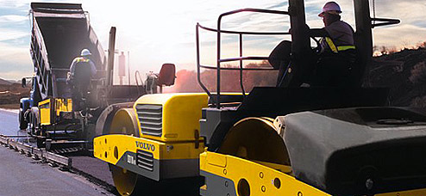
Breakdown Roller
Should Stay Immediately Behind the Paver

Slide 7
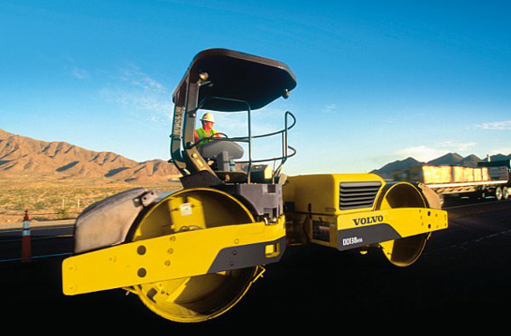
Vibratory Steel Wheel Roller

Slide 8
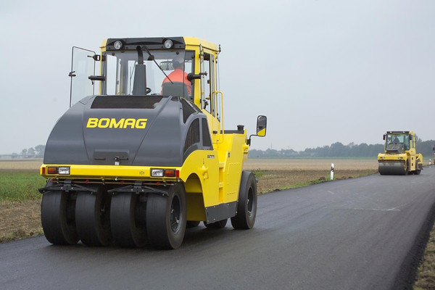
Rubber Tired Roller
Right after breakdown compaction

Slide 9
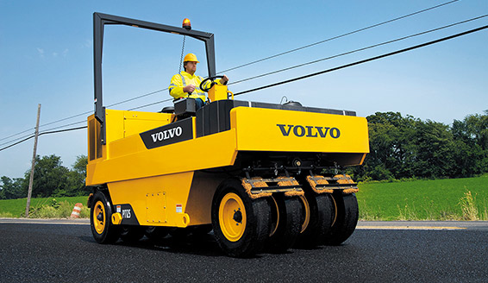
Heaters for the Tires

Slide 10
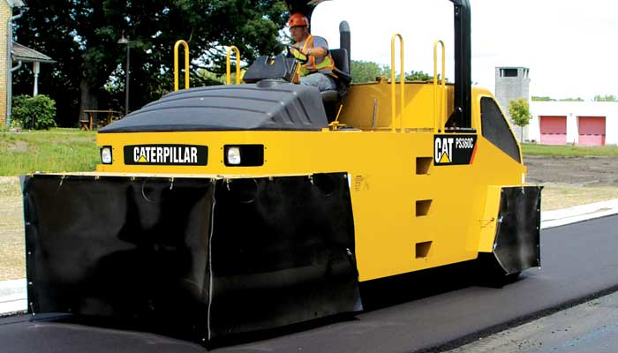
Skirts Around Rubber Tires

Slide 11
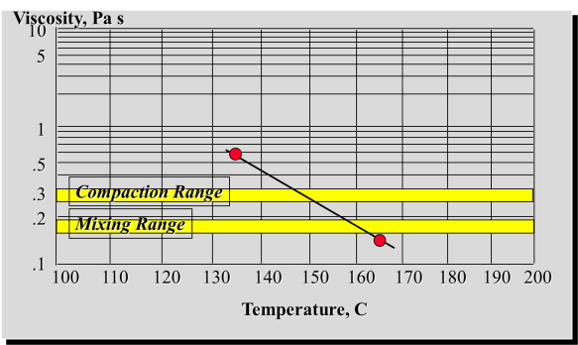
Planning the Compaction Sequence
What is the time window for compaction? (depends on temperature of mix, air, ground, weather, wind, etc)
How many rollers, how many passes?
Rolling patterns

Slide 12
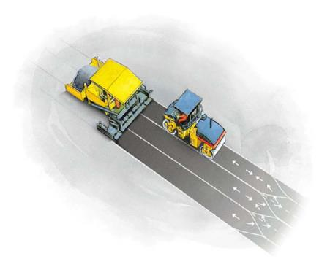
Roller pattern depends on:
Type of compaction equipment
Paving width
Roller width
Number of passes
Roller speed
Number of rollers

Slide 13
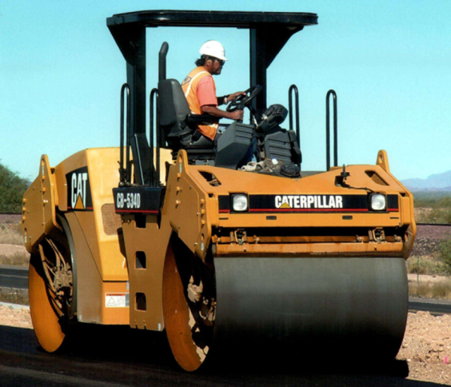
Roller Speed
Rollers Should Operate at a Slow Rate of Speed (about Walking Speed).

Slide 14
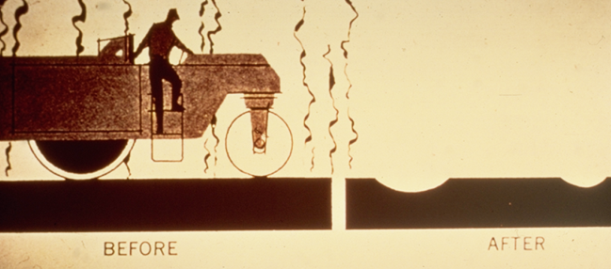

Roller Speed
Not too slow…
Not too fast…

Slide 15
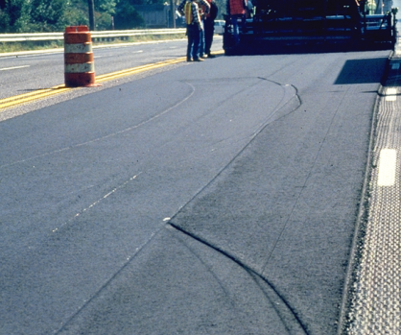
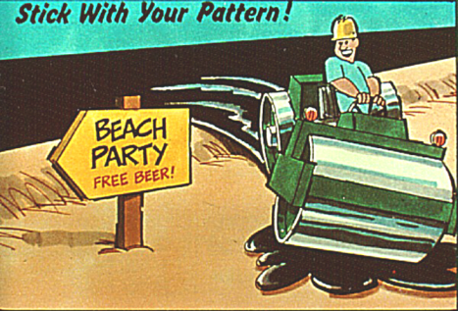
Roller Pattern
Rollers Should Avoid Sudden Stops, Starts, or Turns

Slide 16

Intelligent Compaction
The precise location of the roller, its speed, and number of passes over a given location are mapped using the Global Positioning System (GPS) or a similar system.
To determine the effectiveness of the compaction process, compaction meters are mounted in or about the drum to monitor applied compaction effort, frequency, and response from the material being compacted.

Slide 17
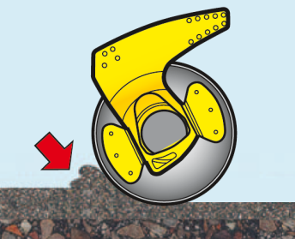
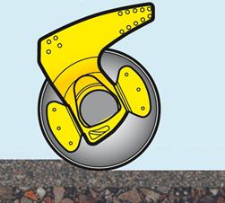
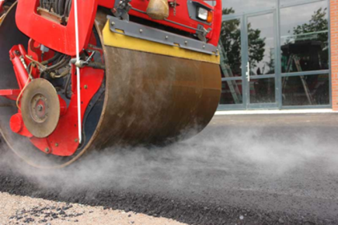
Rolling behavior of HMA
Instable mixture
Stiff mixture

Slide 18
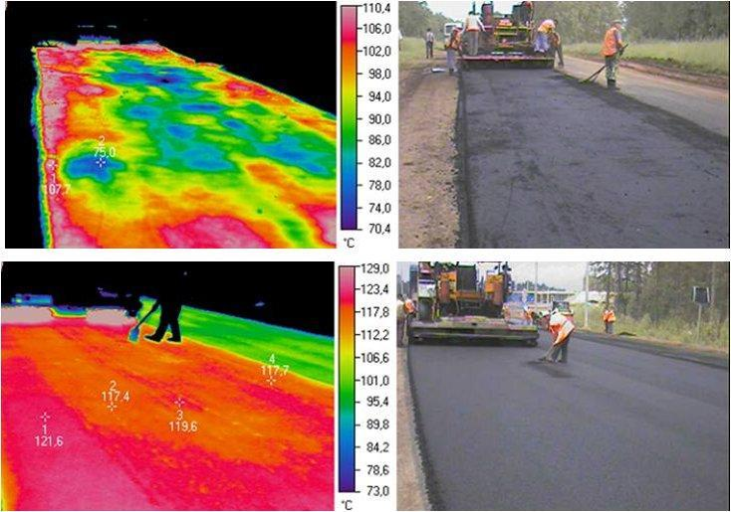
Compaction Temperature

Slide 19
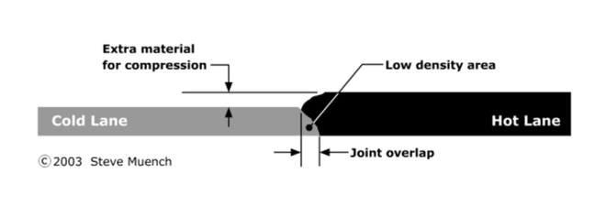
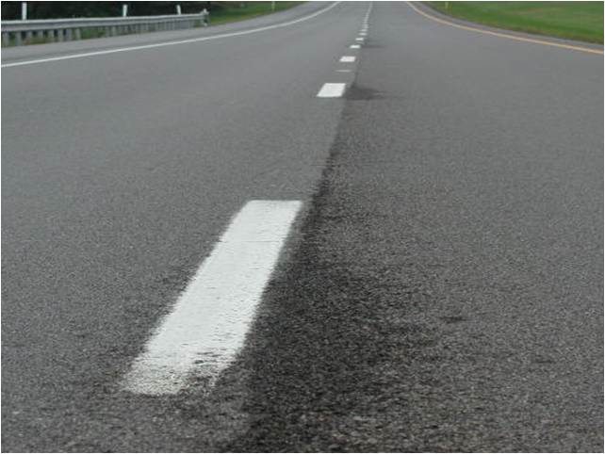
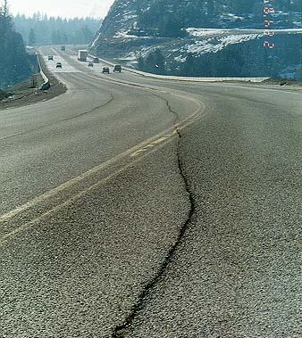
The Longitudinal Joint is Often the Biggest Problem Area
Longitudinal Joint

Slide 20
Cutting Wheel has Been a Very Effective Method to Obtain Density at Longitudinal Joint
Joint Construction Devices
Notched wedge joint
Cutting wheel
Joint maker
Edge restraining device

Slide 21
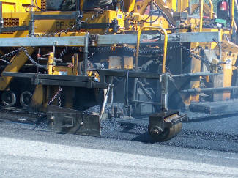
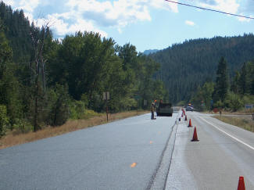
Notched Wedge Joint

Slide 22
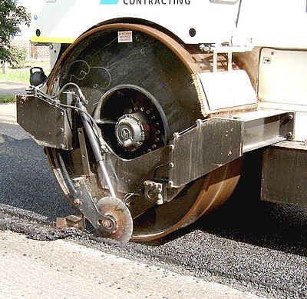
Cutting wheel

Slide 23
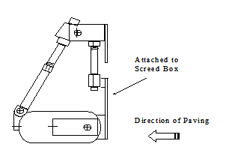
Joint maker

Slide 24
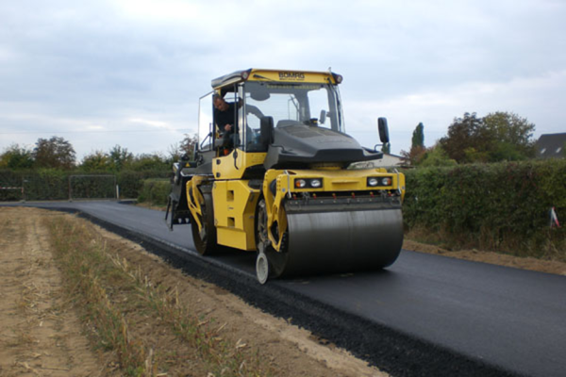
Edge restraining device

Slide 25
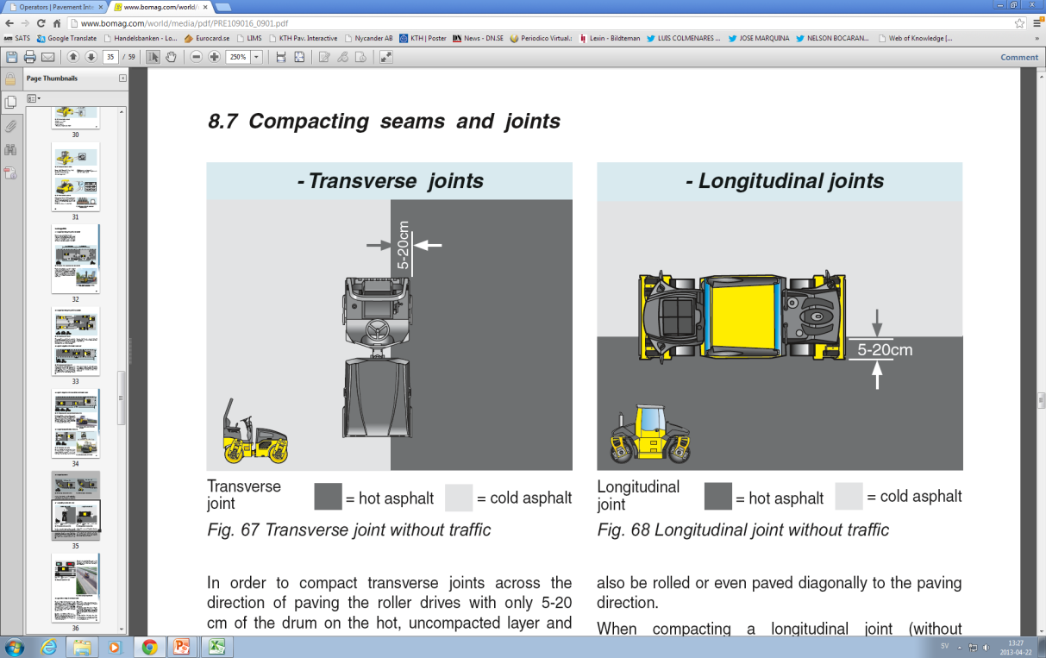
Rolling joints
Longitudinal joints
Transverse joints
Cold mix
Cold mix
Hot mix
Hot mix
Joint Adhesion:
Heat the cold side before placing the hot side.
Coat the cold side with an adhesive material.

Slide 26
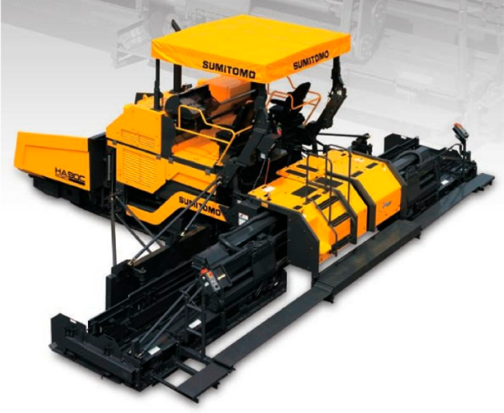
Eliminate Longitudinal Joint
Use paver extension

Slide 27
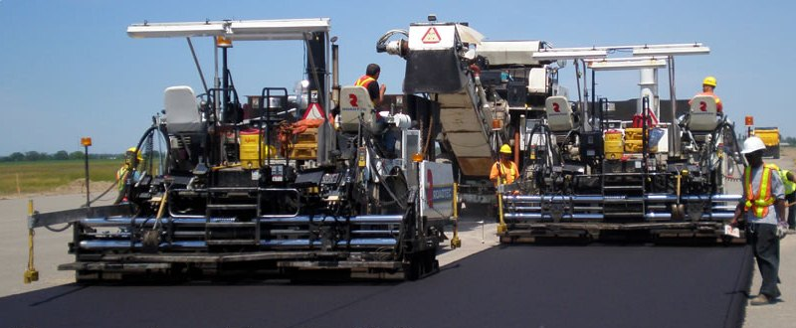

Echelon Paving

Slide 28
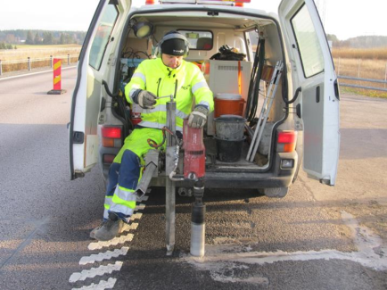
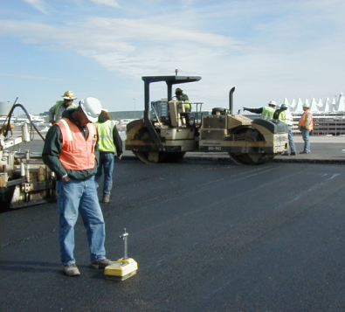
Two Ways to Check Density
Cores
Insitu Measurements

Slide 29
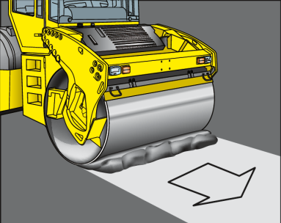

Asphalt Compaction Problems
Scuffing of mix in front of the drum
Mix sticking to the drums

Slide 30
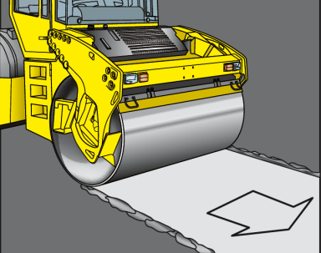
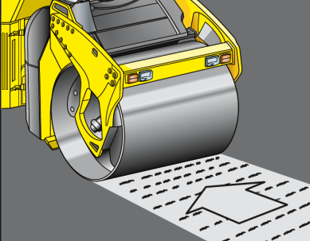
Asphalt Compaction Problems
Cambering along the side of the drum
Transverse cracks behind drum

Slide 31
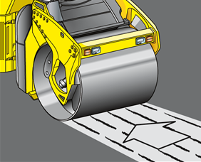
Asphalt Compaction Problems
Longitudinal cracks

Slide 32
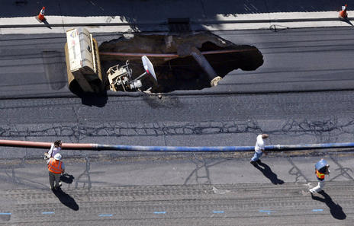
Questions?

