Slide 1
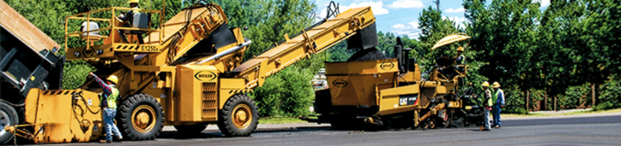
AF2903 Road Construction and Maintenance
Placement of Hot Mix Asphalt
Dr. Alvaro Guarin
Highway and Railway Engineering
Department of Transportation Science

Slide 2
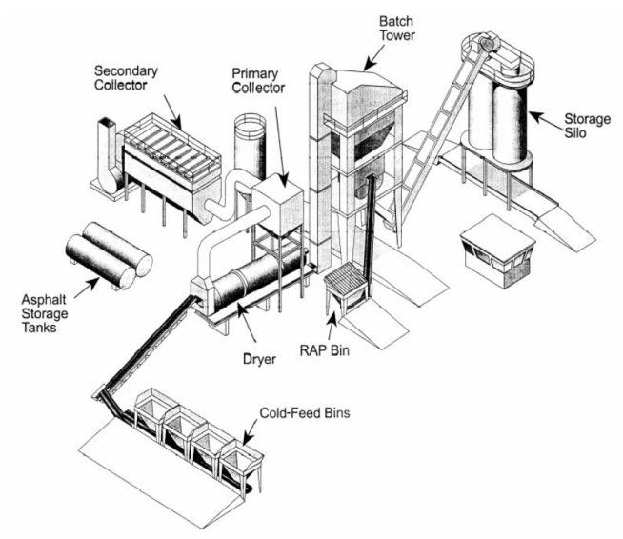
Asphalt Production (Batch Plant)
Notes:
Another type of haul truck is the bottom (or belly) dump truck. The load is delivered from beneath the body into a windrow. The capacity is about 20 to 25 tons. This requires a additional piece of equipment to pickup the material and place it in the hopper. Advantages: no contact with the paver. Keeping windrow correctly sized is ensures consistent mix supply to the paver is very important. These haul units are not used in Florida for asphalt at this time.

Slide 3
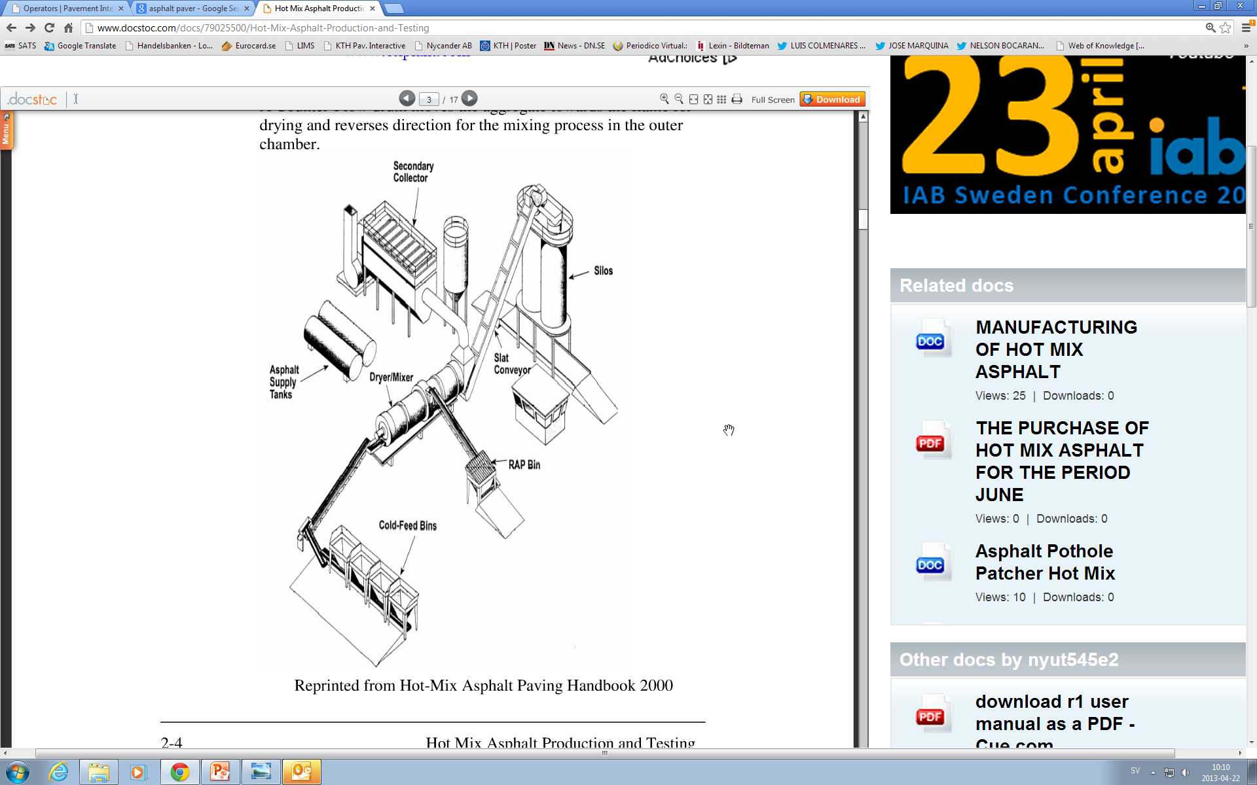
Asphalt Production (Continuous Plant)
Notes:
Another type of haul truck is the bottom (or belly) dump truck. The load is delivered from beneath the body into a windrow. The capacity is about 20 to 25 tons. This requires a additional piece of equipment to pickup the material and place it in the hopper. Advantages: no contact with the paver. Keeping windrow correctly sized is ensures consistent mix supply to the paver is very important. These haul units are not used in Florida for asphalt at this time.

Slide 4
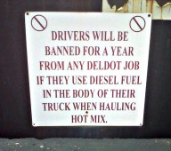

Asphalt Production
Notes:
Once the bed is clean, apply an approved release agent. Non-petroleum materials sprayed uniformly on the sides and bottom–just enough to coat the bed without runoff. Diesel fuel can cause problems with the mix, and is hazardous to the environment.
330-7 Transportation of the Mixture. Transport the mixture in tight vehicles previously cleaned of all foreign material. After cleaning, thinly coat the inside surface of the truck bodies with soapy water or an approved emulsion containing not more than 5% oil. Apply the coating prior to the first loading each day and repeat as necessary throughout the day's operations. After the truck bodies are coated and before any mixture is placed therein, raise them to drain out all excess liquids. Cover each load during cool and cloudy weather and at any time there is a probability of rain.

Slide 5
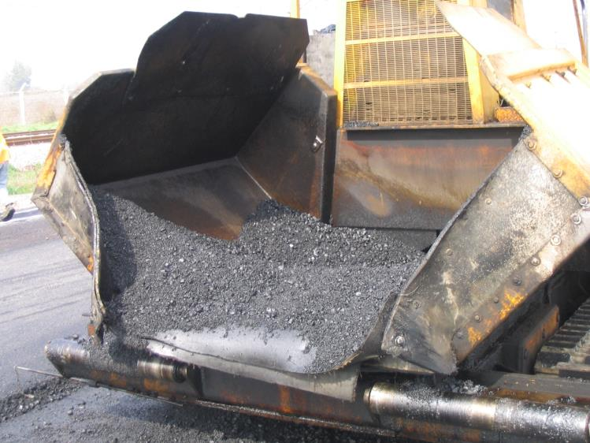
Asphalt Production
Notes:
Once the bed is clean, apply an approved release agent. Non-petroleum materials sprayed uniformly on the sides and bottom–just enough to coat the bed without runoff. Diesel fuel can cause problems with the mix, and is hazardous to the environment.
330-7 Transportation of the Mixture. Transport the mixture in tight vehicles previously cleaned of all foreign material. After cleaning, thinly coat the inside surface of the truck bodies with soapy water or an approved emulsion containing not more than 5% oil. Apply the coating prior to the first loading each day and repeat as necessary throughout the day's operations. After the truck bodies are coated and before any mixture is placed therein, raise them to drain out all excess liquids. Cover each load during cool and cloudy weather and at any time there is a probability of rain.

Slide 6
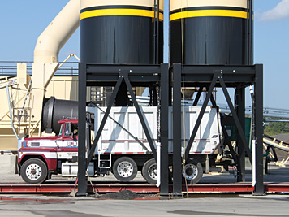
Asphalt Production
Notes:
There are three primary types of HMA haul trucks. Each are loaded at the plant in the same manner from the silo or pugmill. The difference is in how they unload the mix at the paver.
This is an end dump truck. End dump truck delivers mix directly to the paver hopper and have 3 to 6 axles, with a net capacity of 12-20 tons. The advantage of a end dump is that they are most commonly available, have the shortest wheel base, and are the easiest to maneuver.

Slide 7
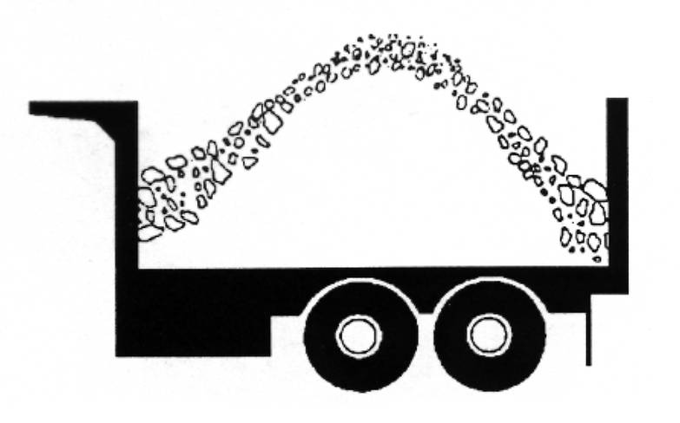
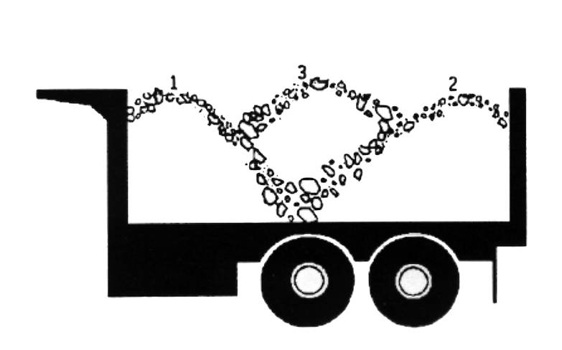
Control segregation
No
Yes
Notes:
Trucks must be in mechanically sound condition. Items to maintain include engine, drive train, hydraulic system, brakes, and lights. The driver is responsible for maintenance.

Slide 8
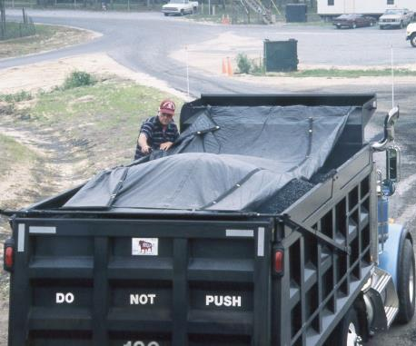
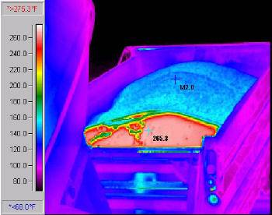
Tarping Loads
Notes:
Here is the completely loaded truck leaving the loadout area heading to pickup his truck ticket and tarp the load.

Slide 9
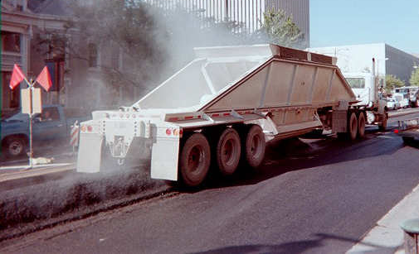
Bottom Dump truck
Notes:
Another type of haul truck is the bottom (or belly) dump truck. The load is delivered from beneath the body into a windrow. The capacity is about 20 to 25 tons. This requires a additional piece of equipment to pickup the material and place it in the hopper. Advantages: no contact with the paver. Keeping windrow correctly sized is ensures consistent mix supply to the paver is very important. These haul units are not used in Florida for asphalt at this time.

Slide 10
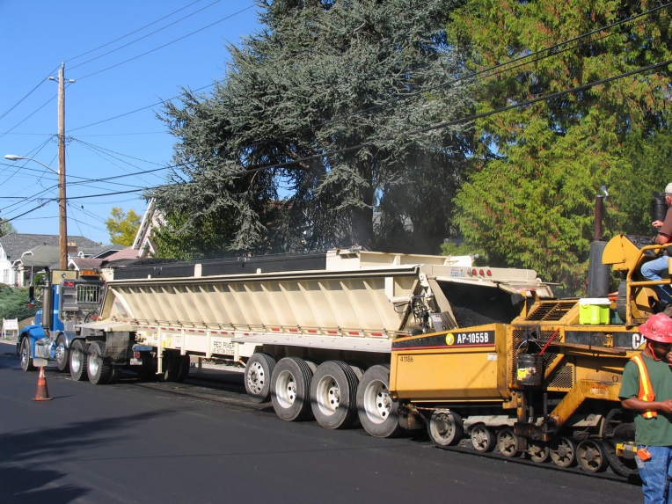
Live Bottom Truck
Notes:
Another type of haul truck is the bottom (or belly) dump truck. The load is delivered from beneath the body into a windrow. The capacity is about 20 to 25 tons. This requires a additional piece of equipment to pickup the material and place it in the hopper. Advantages: no contact with the paver. Keeping windrow correctly sized is ensures consistent mix supply to the paver is very important. These haul units are not used in Florida for asphalt at this time.

Slide 11
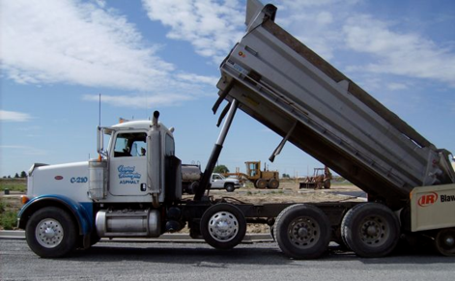
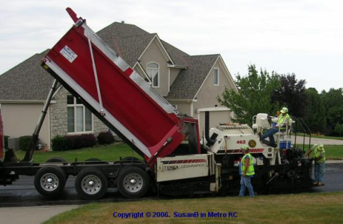
End Dump Truck
Notes:
Another type of haul truck is the bottom (or belly) dump truck. The load is delivered from beneath the body into a windrow. The capacity is about 20 to 25 tons. This requires a additional piece of equipment to pickup the material and place it in the hopper. Advantages: no contact with the paver. Keeping windrow correctly sized is ensures consistent mix supply to the paver is very important. These haul units are not used in Florida for asphalt at this time.

Slide 12
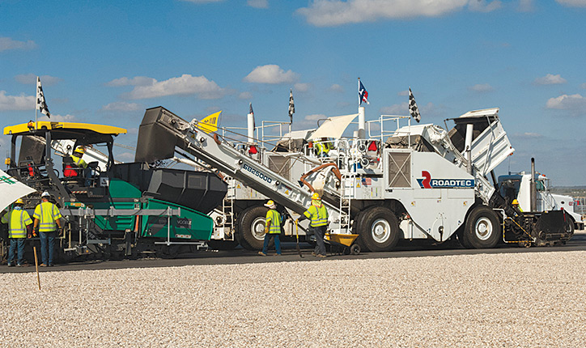
Materials Transfer Vehicle
Notes:
The original Materials Transfer Vehicle (MTV) also known as the Shuttle Buggy is manufactured by by Roadtec, a division of ASTEC Industries.
It consists of a receiving hopper, and slat conveyor, a holding and remixing chamber in the center of the machine, and a discharge conveyor. Coupled with a hopper insert, this device has the capability of holding approximately two extra truck loads of mix.

Slide 13
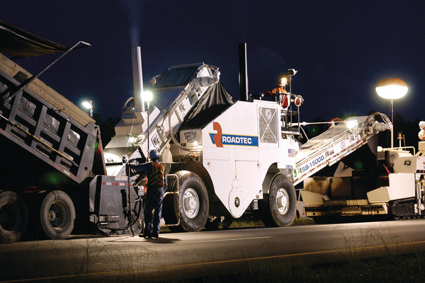
Materials Transfer Vehicle
Notes:
The original Materials Transfer Vehicle (MTV) also known as the Shuttle Buggy is manufactured by by Roadtec, a division of ASTEC Industries.
It consists of a receiving hopper, and slat conveyor, a holding and remixing chamber in the center of the machine, and a discharge conveyor. Coupled with a hopper insert, this device has the capability of holding approximately two extra truck loads of mix.

Slide 14
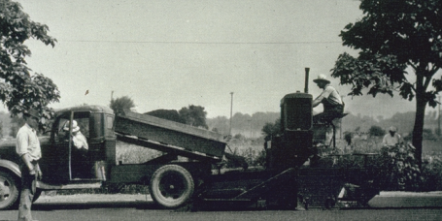
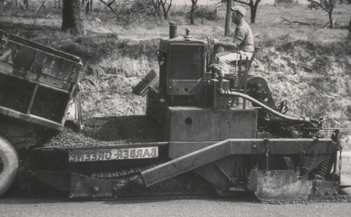
Self Propelled Paving Machine
THE BASIC PRINCIPLE HAS NOT CHANGED MUCH
Notes:
The basic principle behind the pavers has not changed much since the 1930s.

Slide 15
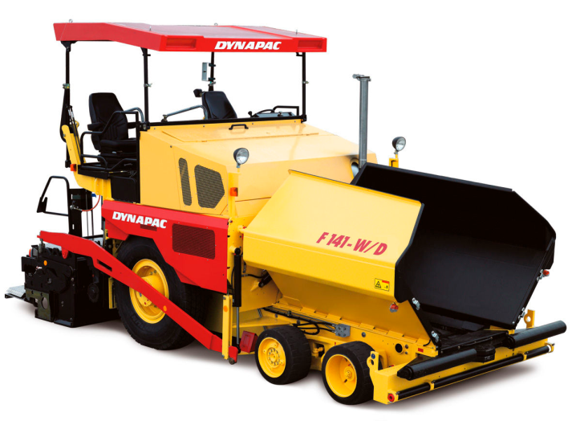
Types of Pavers
Wheel type
Notes:
The third type of haul unit is the horizontal discharge (or live bottom) truck. The operate by using a conveyor belt or slat conveyor which discharges mix from back, without raising bed, directly into paver. Capacity varies; truck shown has 45 tons payload, used only in Michigan.

Slide 16
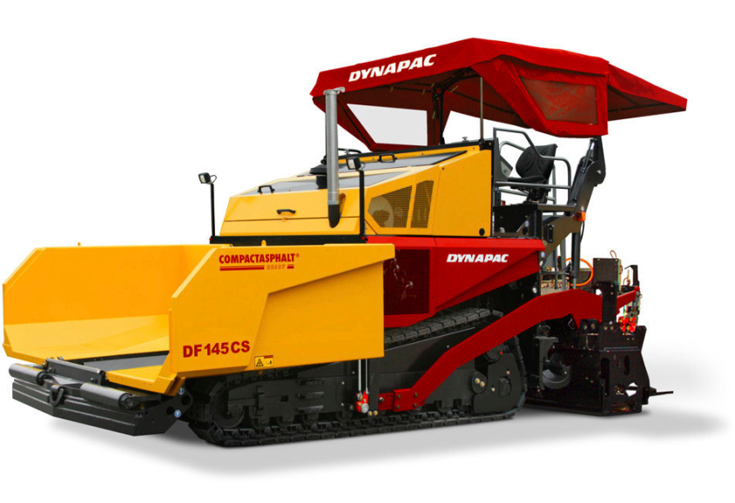
Types of Pavers
Track type
Notes:
The third type of haul unit is the horizontal discharge (or live bottom) truck. The operate by using a conveyor belt or slat conveyor which discharges mix from back, without raising bed, directly into paver. Capacity varies; truck shown has 45 tons payload, used only in Michigan.

Slide 17
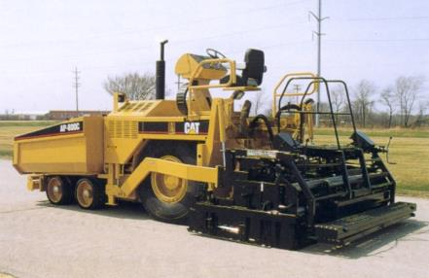
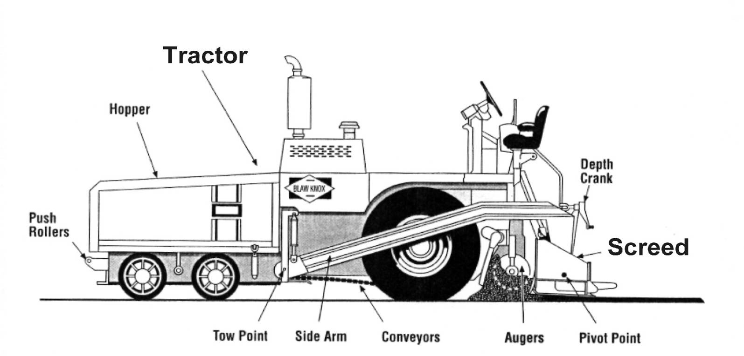
Pavers (Key parts)

Slide 18
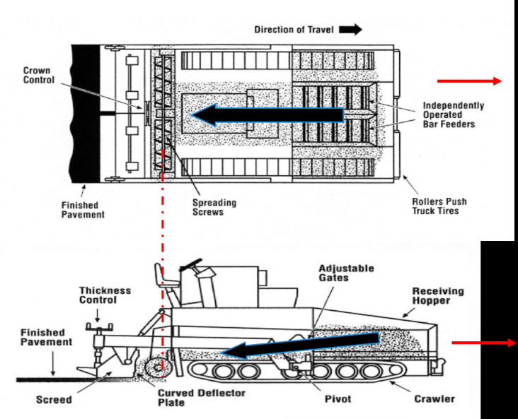
Material Flow

Slide 19
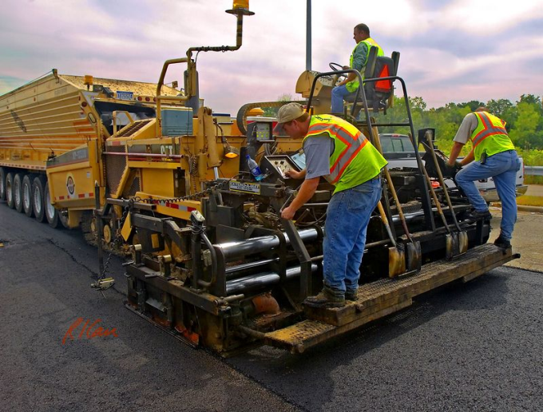
Paver Operation

Slide 20
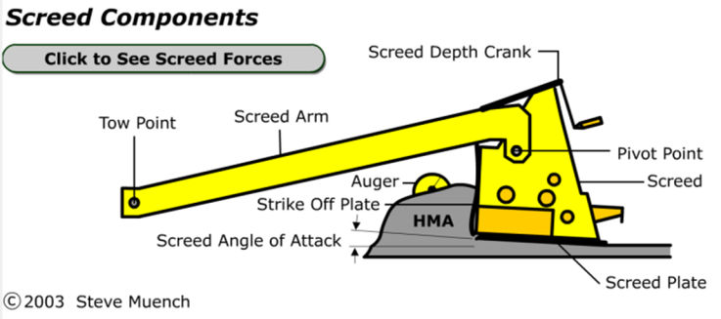
Operational Principles of the Screed
Self-leveling concepts
Screed response versus distance
Forces acting on a screed
Notes:
The next item to discuss is the operational principles of the screed.

Slide 21
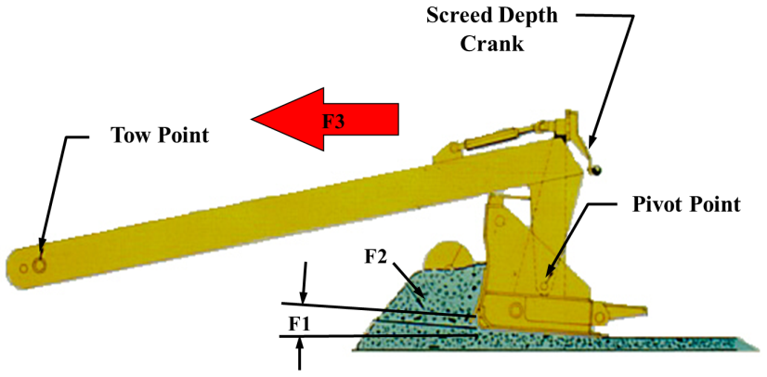
Main Forces Acting on Screed
Speed of paver
Head of material
Angle of attack
Other forces
  Pre-compaction
  Screed weight
Notes:
The self-leveling action of the screed means it will respond to the various forces acting on it to find its balance or equilibrium. The three main forces acting on the screed and how thick it places the mat are...

Slide 22
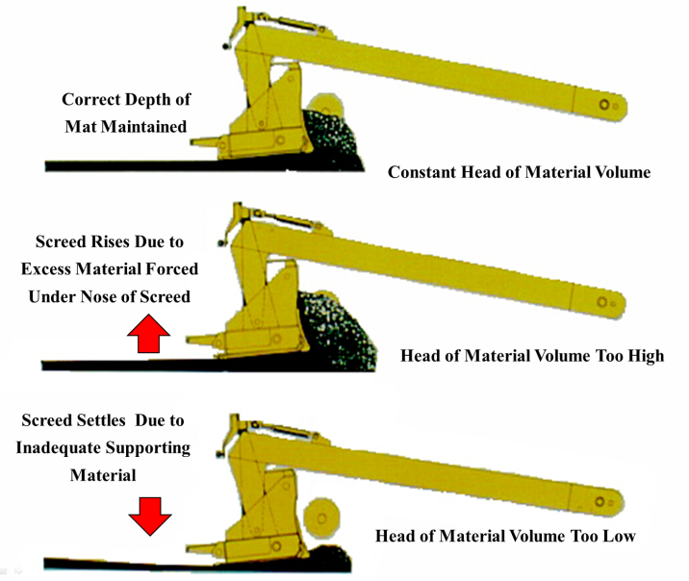
Head of Material (Screed)

Slide 23
Types of Grade Reference
Stringline
Mobile reference
Joint matching shoe
Sonic sensor
Laser guided controls
Notes:
Three types of grade control references. Grade references can be used alone on either side of the paver, or on both sides. One type can be used on one side (e.g. stringline) and one on another (e.g. ski).

Slide 24
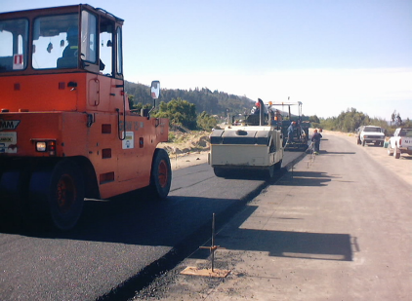
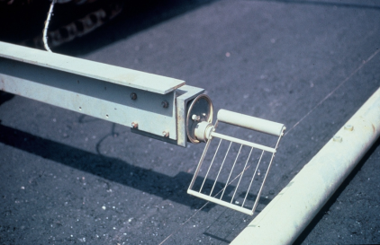
Stringline

Slide 25
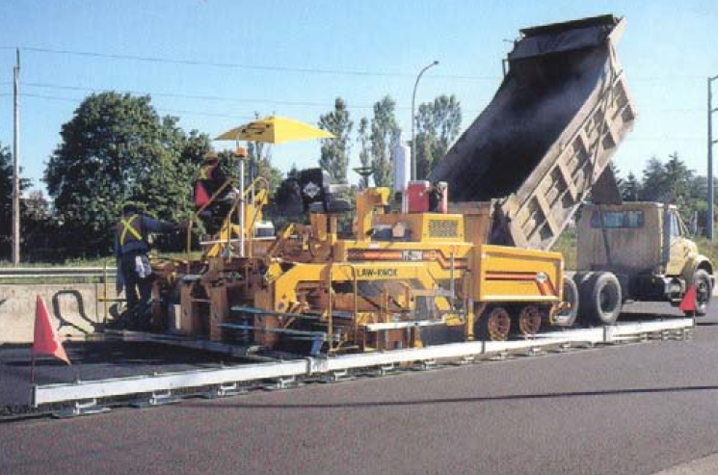
Mobile Reference

Slide 26
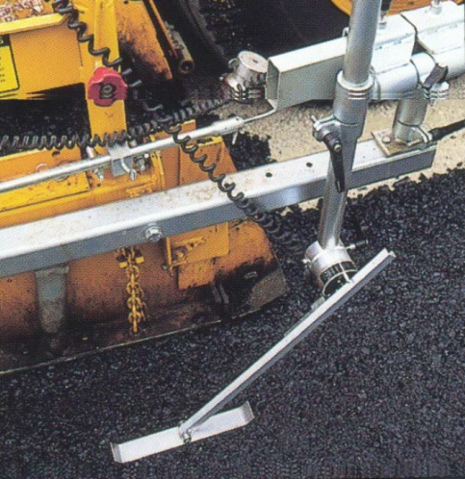
Joint Matching Shoe

Slide 27
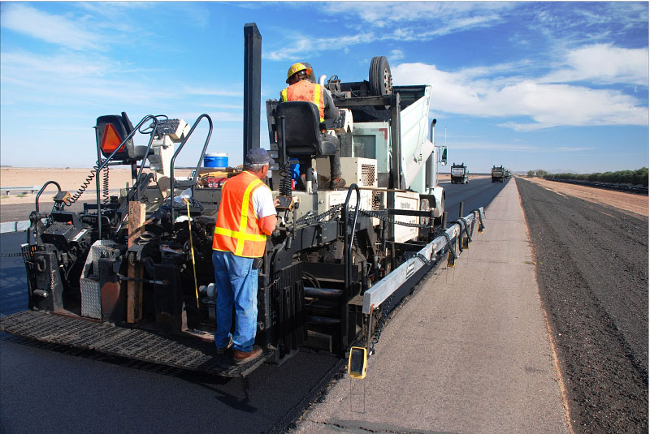
Sonic Sensor

Slide 28
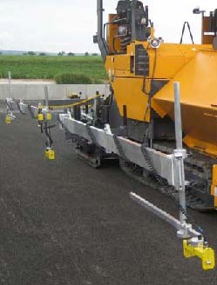
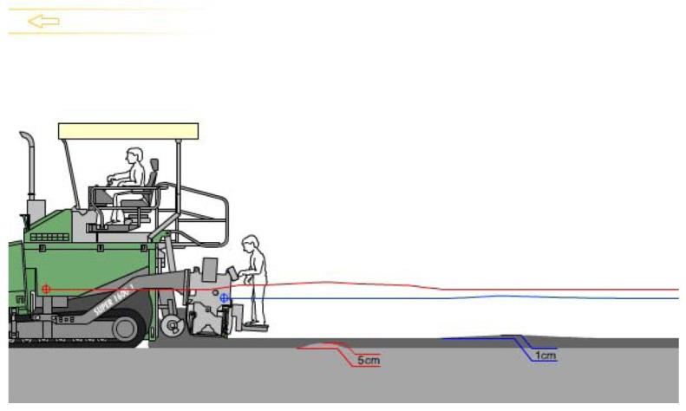
Laser guided controls

Slide 29
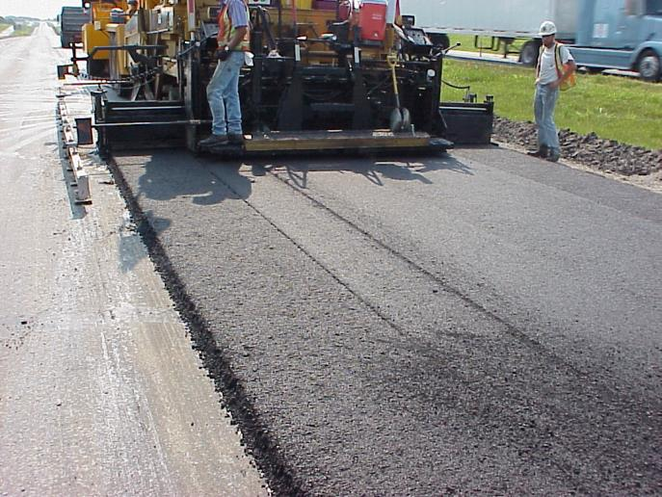
Mixture Laydown Problems
Notes:
Ask: Is this a problem? (No uniform density from screed.)
Ask: What caused double line? (Misaligned extendable screed.)

Slide 30
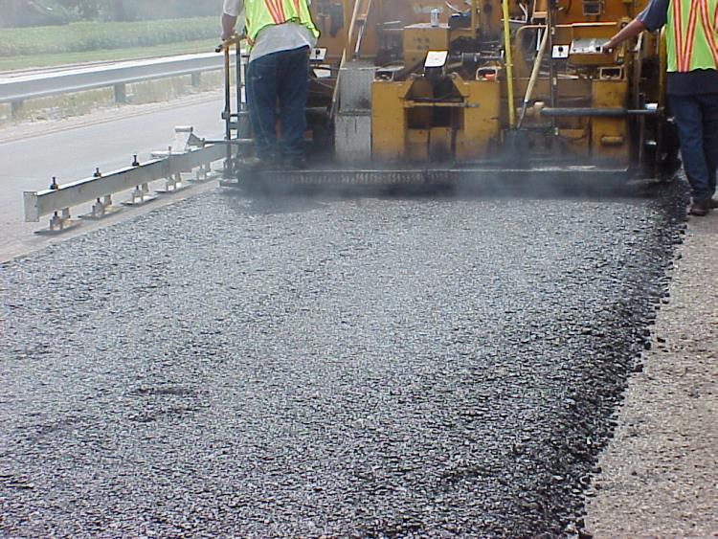
Mixture Laydown Problems
Centerline
Segregation
Notes:
Define Texture Differential compared to segregation.
Segregation is large aggregate in sufficient quantity to be seen, lack of fines, and normally shows up in longitudinal streaking. This is normally an auger feeding problem.

Slide 31
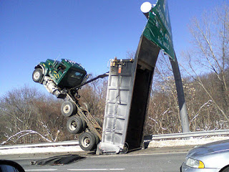
Questions?

