Slide 1
Evaluation methods
How do we judge speech technology components and applications?

Slide 2
Why should we talk about evaluation? •
It is – or should be – a central part of most, if not all, aspects of speech technology
The higher grades (A, B; as tested in the home exam assignments and the project) require a measure of evaluation

Slide 3
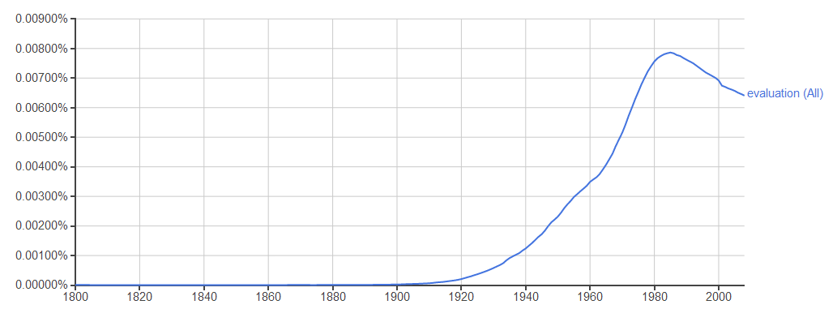
What is evaluation? •
“the making of a judgment about the amount, number, or value of something” (Google)
“the systematic determination of a subject's merit, worth and significance, using criteria governed by a set of standards” (Wikipedia)

Slide 4
What is evaluation?
“The systematic determination of a subject's merit, worth and significance, using criteria governed by a set of standards?”
What does this mean?
  The method can be formalized, described in detail…
Why is this important?
  So that evaluations can be repeated,
  because we want to compare different systems,
  and verify evaluation results
Notes:
It can be formalized.
So that it can repeated.
We want to compare.
And we want to verify.

Slide 5
What is evaluation?
“The systematic determination of a subject's merit, worth and significance, using criteria governed by a set of standards?”
(Google had “value” instead)
What does this mean?
  We will return to this…
Notes:
Context dependant.
These questions can be rephrased. For whom, to whom, when?

Slide 6
What is evaluation?
“The systematic determination of a subject's merit, worth and significance, using criteria governed by a set of standards?”
What are the criteria?
  We will come back to this, too...
Who decides on the standards? •
  Governments
  Organizations (e.g. ISO)
  Industry groups
  Research groups
  …
Notes:
Context dependant.
These questions can be rephrased. For whom, to whom, when?

Slide 7
What if there is no standard?
By the nature of things, there are many more things to evaluate than there are well-developed standards
Not necessarily advisable to use a mismatched standard
Fallback: systematic, formalized method

Slide 8
Why evaluate?
Wrong question. Start with “For whom do we evaluate?” •
  Researchers
  Developers
  Producers
  Buyers
  Consumer organizations
  Special interest groups
  …
Notes:
For whose benefit?

Slide 9
So now: Why evaluate ? •
  What do the groups we mentioned want from an evaluation?
  Researchers?
    Test of hypotheses…
  Developers
    Proof of progress, functionality
  Producers
    Does the manufacturing work?
    Is it cheaper?
  Buyers
    More bang for the buck?
    Does it meet expectations?
  Consumer organizations
    Does it meet promises made?
  Special interest groups
    Does it meet specifcations and requirements?

Slide 10

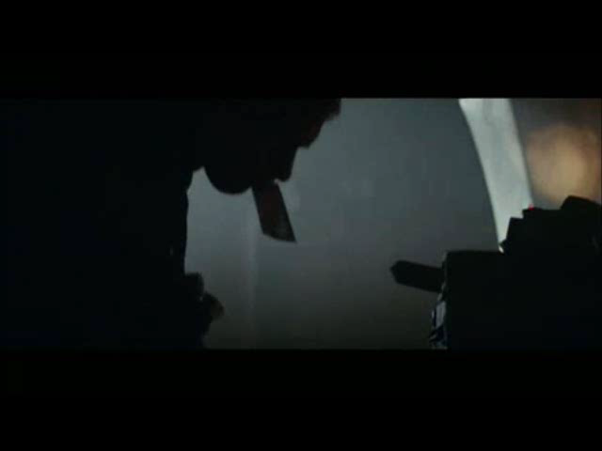
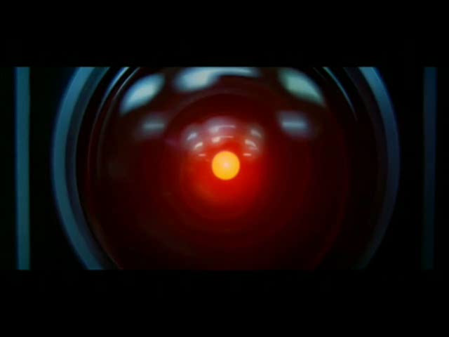
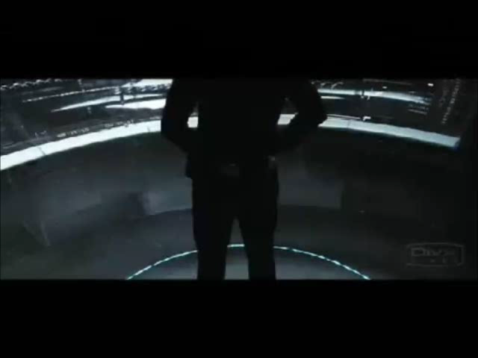
What to evaluate? •
In other words, what does “merit, worth, significance” and “value” mean?
Notes:
TMH
Blade runner
Hal
Minority report

Slide 11
What to evaluate? •
In other words, what does “merit, worth, significance” and “value” mean?
It depends.
  What is the purpose of the evaluation?
  What is the purpose of the evaluated?
Notes:
TMH
Blade runner
Hal
Minority report

Slide 12
In summary so far
Objective to a point
  But be aware of the reason for the evaluation: who wants it, and what do they want to know?
Standards are great
  But will not be available for all purposes
  Squeezing one type of evaluation into another type of standard will produce unpredictable results
  If designing new methods, be very clear with the details in the description
    Must be possible to repeat

Slide 13
How is evaluation done?
We’ll use speech synthesis evaluation as our example domain
Here, we focus on evaluations that
  Test the functionality (with respect to a user)
  Prove a concept or an idea
  Compare different varieties
  …
We largely disregard
  Efficiency
  Cost
  Robustness
  …

Slide 14
User studies – representativeness
User selection
  Demographics
  …
Environment
  Sound environment
  …
General situation
  Lab environments are rarely representative for the intended usage environment of speech technology
  …
Stimuli/system
  Often not possible to text the exact system one is interested in

Slide 15
Synthesis evaluation overview
  Overview used by MTM, the Swedish Agency for Accessible Media in education
Provides people with print impairments with accessible media
Books and papers (games, calendars…)
Braille and talking books
Speech synthesis for about 50% of the production of university level text books
Filibuster
  In-house developed unit selection system
  Tora & Folke (Swedish), Brage (Norwegian bokmål), Martin (Danish)

Slide 16

MTM purposes of evaluation
Ready for release
Comparison of voices
Intelligibility, human-likeness
Fatigue, habituation
…

Slide 17
Test methods: Grading tests
Overall impression (mean opinion score, MOS)
  Grade the utterance on a scale
  Specific aspects (categorical rating test, CRT)
    Intelligibility
    Human-likeness
    Speed
    Stress
    …

Slide 18
Test methods: Discrimination tests
  Repeat or write down what you heard
  Choose between two or more given words
    Minimal pairs: bil – pil
    Suitable for diphone synthesis with a small voice database

Slide 19
Test methods: Preference tests
  Comparison of two or more utterances
    Typically words or short sentences
    Choose which you like the best

Slide 20
Test methods: Comprehension tests
  Listen to a text and answer questions

Slide 21
Test methods: Comments
  Comment fields
    The subjects wants to explain what is wrong
    They are almost never right.
    Time consuming!

Slide 22
Test methods: problems for narrative synthesis testing
  You want to evaluate large texts!
  Grading, discrimination and preference tests
    Difficult to judge longer texts
    Evaluation of a very small part of the possible outcome of the US TTS
    Time consuming
    You don’t know what the subjects likde or disliked
  Comprehension tests
    Does not measure anything else

Slide 23
Ecological validity
    Representativeness again: ecological validity means that the methods, materials and setting of the study should approximate the real-world that is being examined
    Users e.g. students, old people
    Material university level text book or newspapers with synthetic speech
    Situation reading long texts (in a learning or informational situation)

Slide 24
Audience response system-based tests
  Hollywood: evaluations of pilot episodes and movies
    Clicking a button when the don’t like it
  Voting in TV shows
  Classroom engagement

Slide 25
Audience response system-based test
  For TTS
    Click when you hear something
      Unintelligible
      Irritating
      You just don’t like it
      …
  Longer speech chunks
  Possible to give simple instructions
  Detailed analysis
  Effectiveness
    5 listening minutes = 5 evaluated minutes

Slide 26
Results – number of clicks/subject

Slide 27
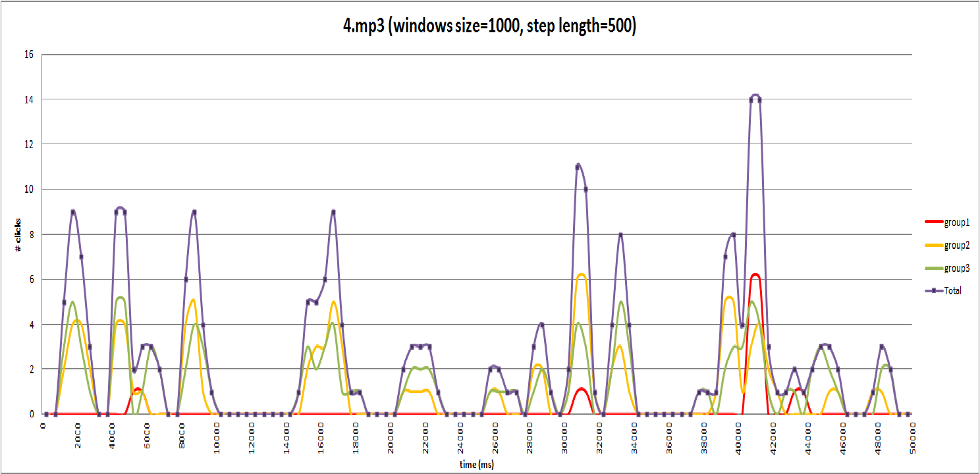
Results – number of clicks/subject

Slide 28
Evaluation of conversational systems and conversational synthesis
Conversations are incremental and continuous
  No straightforward way of segmenting
They are produced by all participants in collaboration
“Errors” are commonplace, but rarely have an adversary effect
Strict information transfer is often not the primary goal
So not much use for methods of evaluation that operate in terms of
  Efficiency
  Quality of single utterances
  Grammaticality
  Etc.

Slide 29
Other methods
New methods are being developed for evaluation of complex systems and interactions.
ARS is one.
We’ll look at some other examples.

Slide 30
Analysis of captured interactions
Measures of machine extractable features, e.g. tone, rhythm, interaction flow, durations, movement, gaze…
Comparison to human-human interactions of the same type
The colour experiment is an example of this

Slide 31
3rd-party participant/spectator behaviours
People watching spoken interaction behave predictably
Monitoring people watching videos can give insights to their perception of the video
E.g. gaze patterns

Slide 32
Thank you!
Questions?

