Slide 1
making a game in your spare time
Alessandro Pieropan

Slide 2
What is this about
My experience so far
Mobile game programming
Divine Guidance

Slide 3
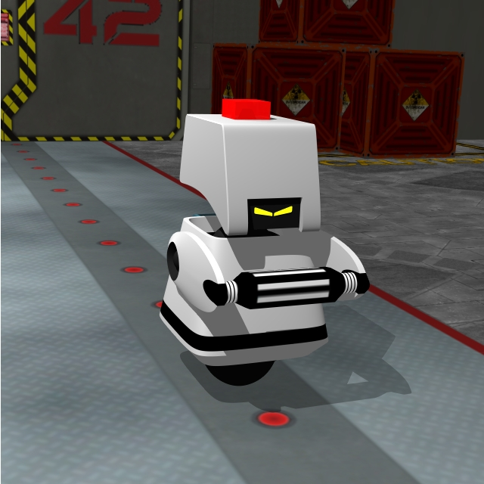
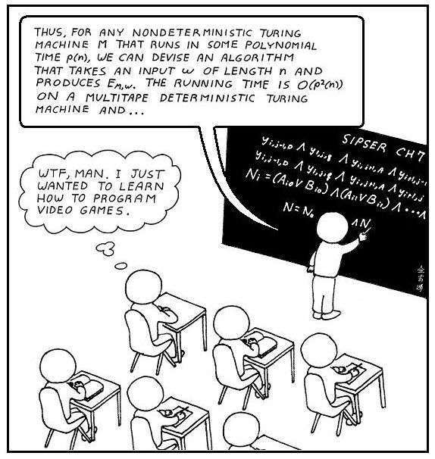
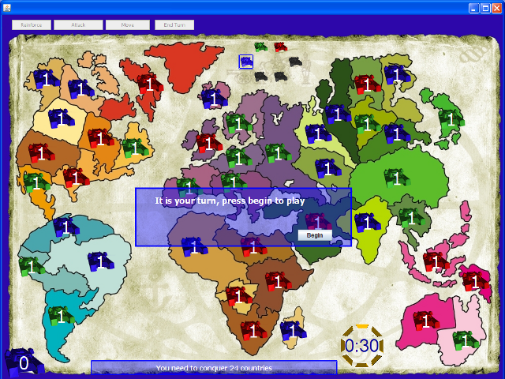
Who I AM
Computer Scientist
Passion for Computer Graphics and A.I.
Love RTS games
Phd student in Computer Vision and Robotics

Slide 4
Game IDEA
Hobby project
Mobile game
6 months (6-10 hours per week)
Advert type game
4 people (coder, artist, game designer, marketing)

Slide 5
“ From Scratch ” OR Game Engine ?

Slide 6






Game Engines

Slide 7
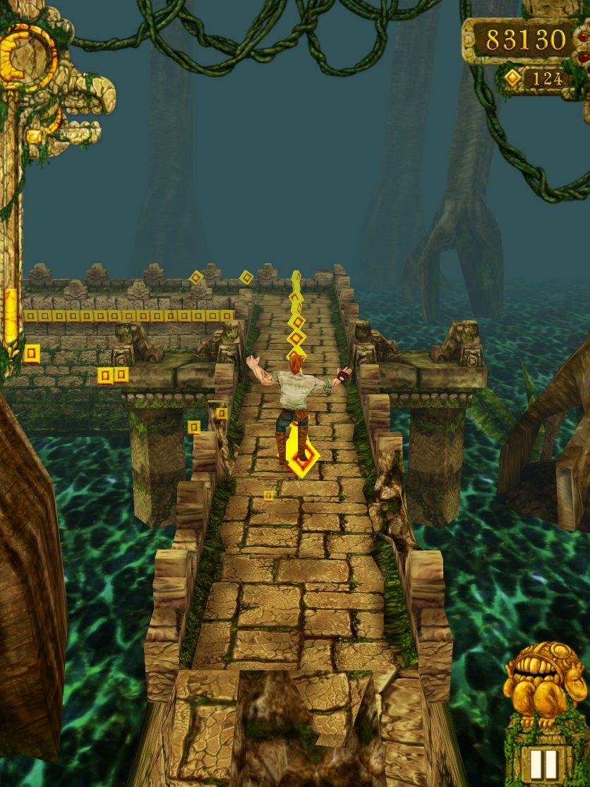
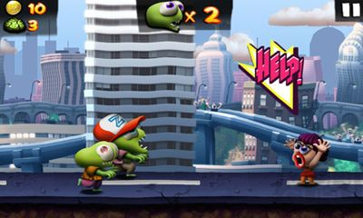
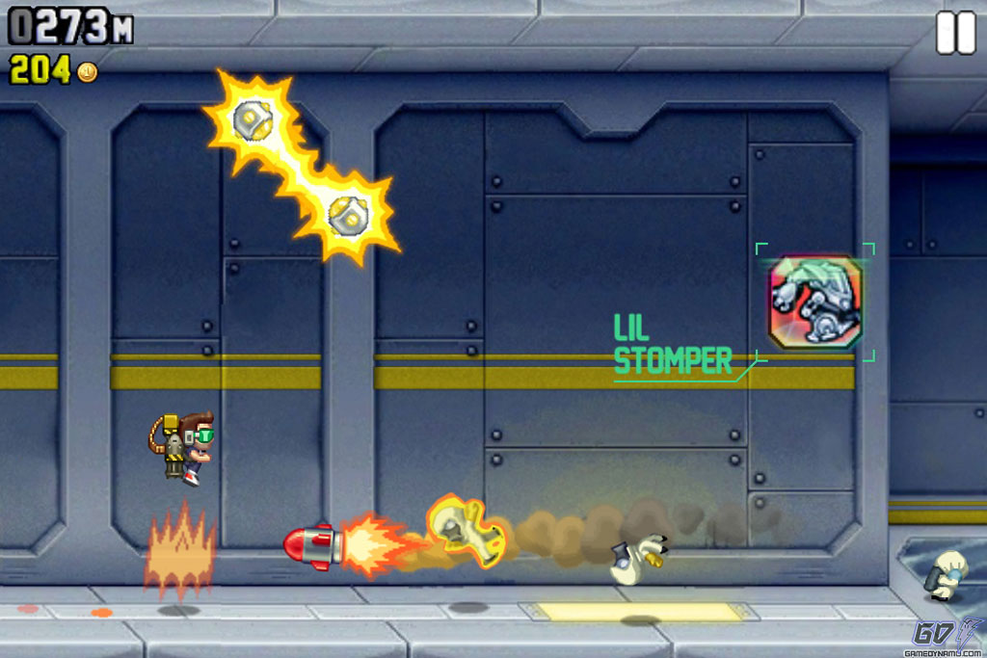
Game type?

Slide 8
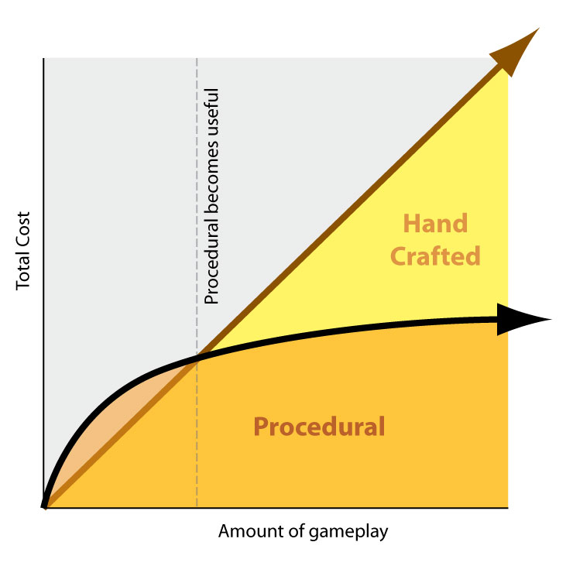
Hand crafted or procedural?

Slide 9
Successfull examples

Slide 10
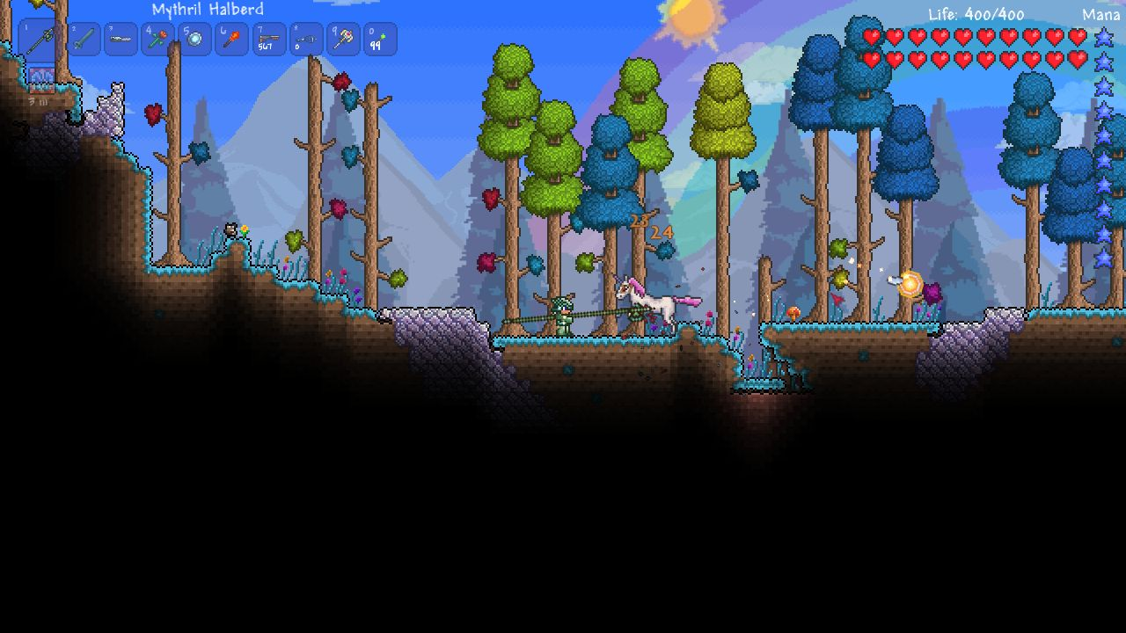
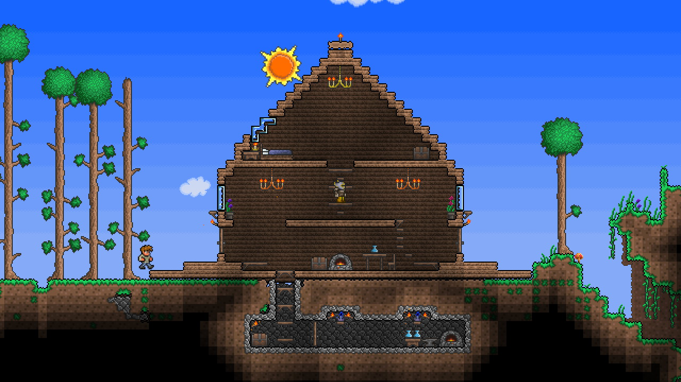

Slide 11
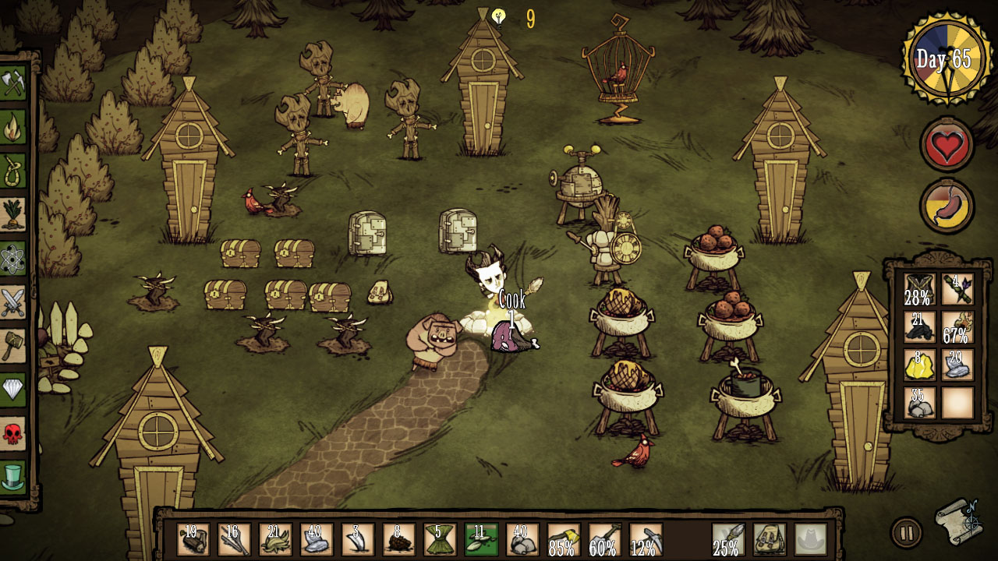

Slide 12
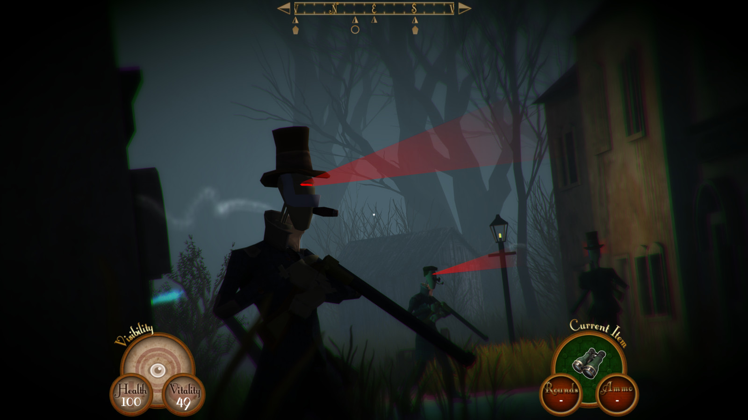

Slide 13
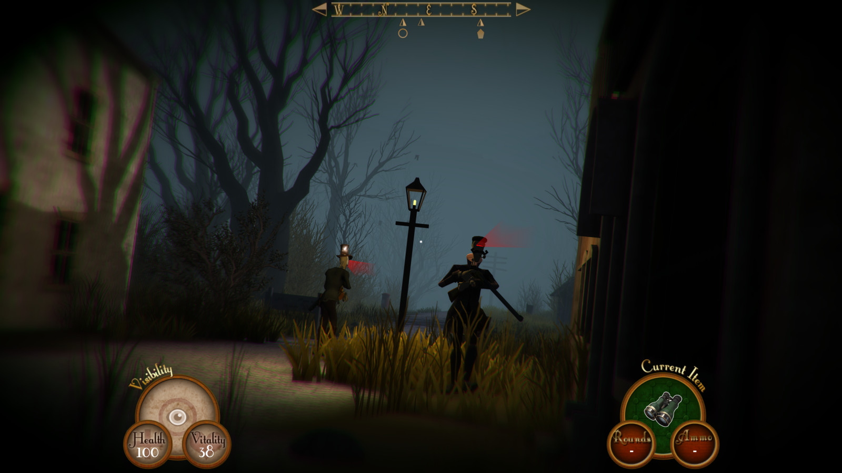

Slide 14
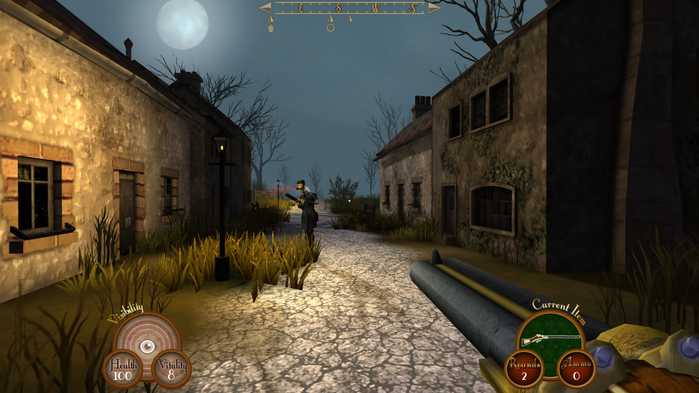

Slide 15
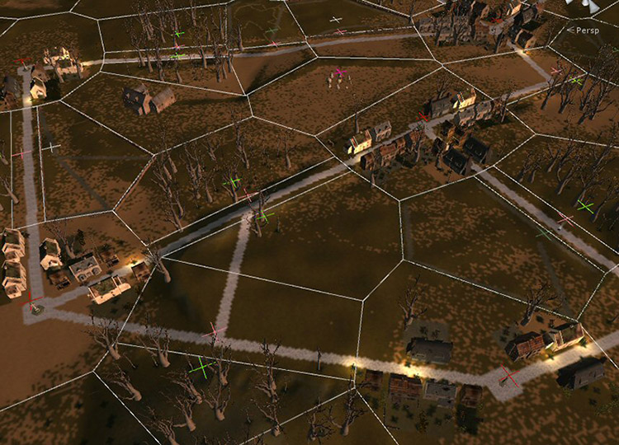
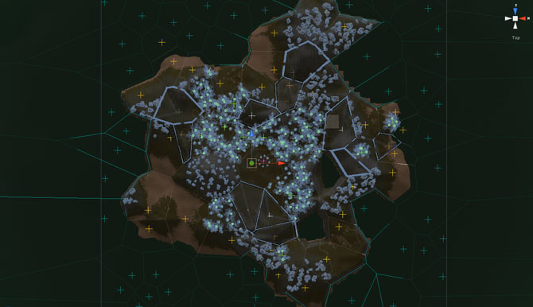
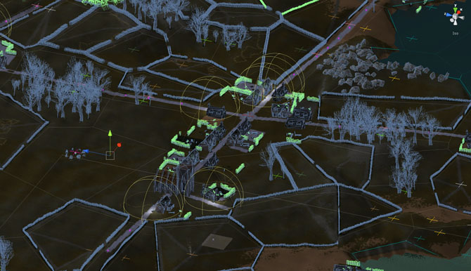
Sir, you are being hunted
Voronoi-delauny dual graph
Fractal heightmap
Terrain processing
Biome regions with local generation logic
Loot table invetories
Emergent Behavioural AI

Slide 16
Divine guidance

Slide 17
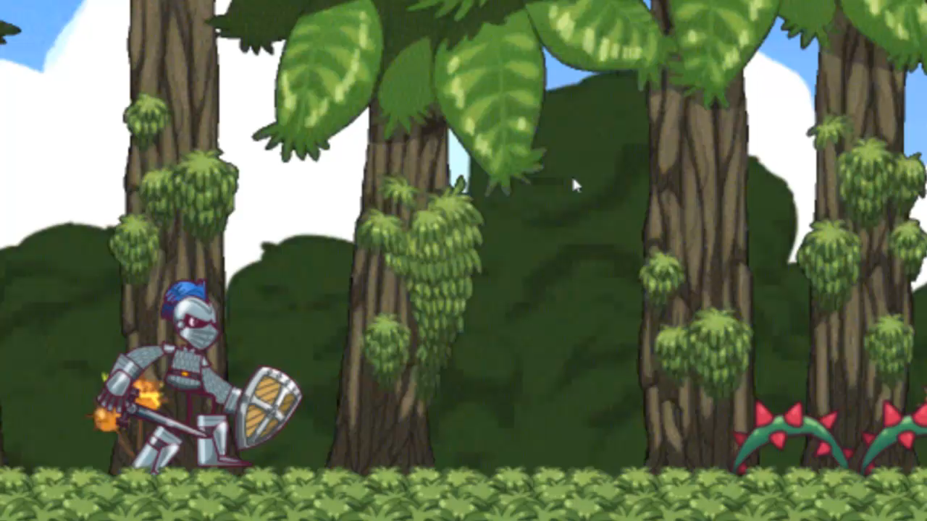

Slide 18






Procedural Generation and gameplay
Has to be feasible
Has to be fun
Has to be challenging
Randomized
Interval

Slide 19
Mobile Constraints
60 FPS on any android device
Fast loading time
Downloadable content smaller than 20 mb

Slide 20
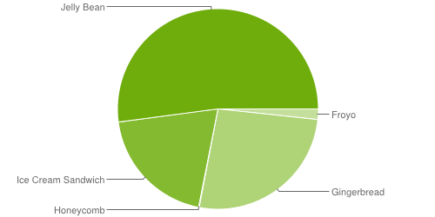
Platform Version
Version | Codename | Distribution
2.2 | Froyo | 1.7%
2.3 | Gingerbread | 26.3%
3.2 | Honeycomb | 0.1%
4.0 | Ice Cream | 19.8%
4.1 | Jelly Bean | 37.3%
4.2 | Jelly Bean | 12.5%
4.3 | Jelly Bean | 2.3%

Slide 21
Common Problems

Slide 22
Alpha TESTING
Manual drawing order
Orthographic camera
Shaders

Slide 23

Pooling system
IN USE
POOL
Total allocated enemies

Slide 24
Dynamic Batching
Draw calls are expensive
Unity draws all objects that share the same material and texture at once
Have as many objects as possible with the same material
Sore many textures in one big texture (atlasing)

Slide 25
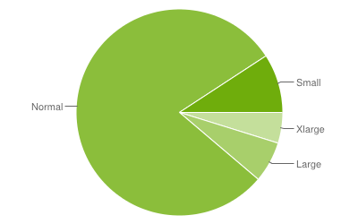
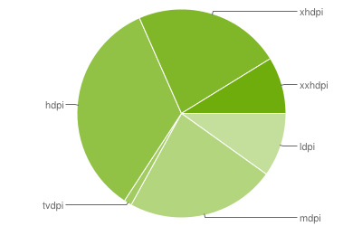
Aspect ratio

Slide 26
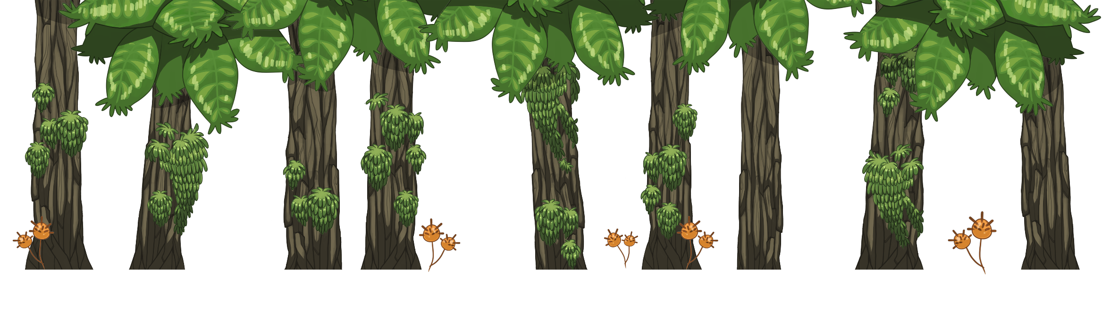

Parametrized appearance
0.85
0.15

Slide 27

Texture Size
Tradeoff between texture quality and size

Slide 28
Don’t use unity gui system

Slide 29
tips
Find a team
Have an arstist !!!
Understand the game engine
Be realistic
Have a playable prototype as soon as possible
Go to events (SGA, UNITE, …)

Slide 30
The last 10% takes 90% of the time...

Slide 31
Want to test it?
Alessandro.pieropan@gmail.com

Slide 32
Thanks!

