Slide 1

Reservoir simulation and meliorate the hydropower production
Hadi Madani,WST program
mhmadani@kth.se
Supervisors:
Anders worman
worman@kth.se
Sezar moustafa
sezar.moustafa@fortum.com
James yang
james.yang@vattenfall.com

Slide 2

Hydropower and Sustainability
What causes Global Warming ?
Who produces global warming ?
Impact of Global Warming
Impacts of Global Warming in Sweden
What should we do NOW ?
Hydropower Regulation

Slide 3
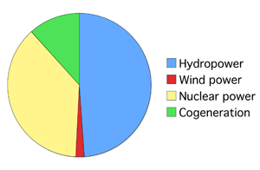
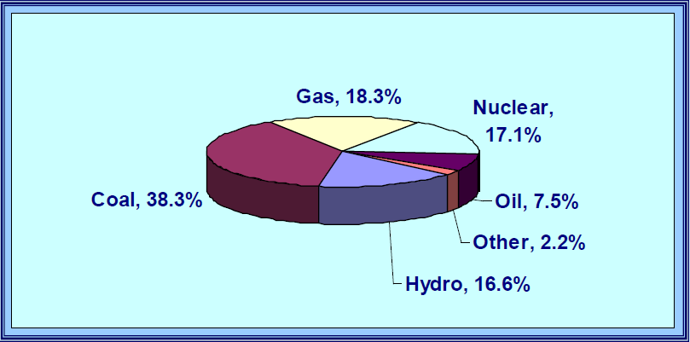
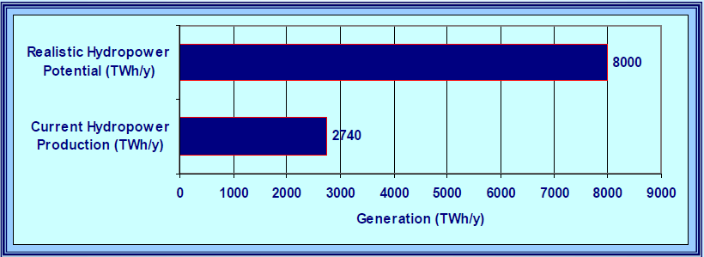
Advantages of Hydropower
Hydro Reservoirs and GHG Emissions
World Electricity Generation
World’s Potential Hydropower Generation
Application of Reservoir Simulation for Power Melioration
New Operation Rules for Lule and Ore River Basin

Slide 4

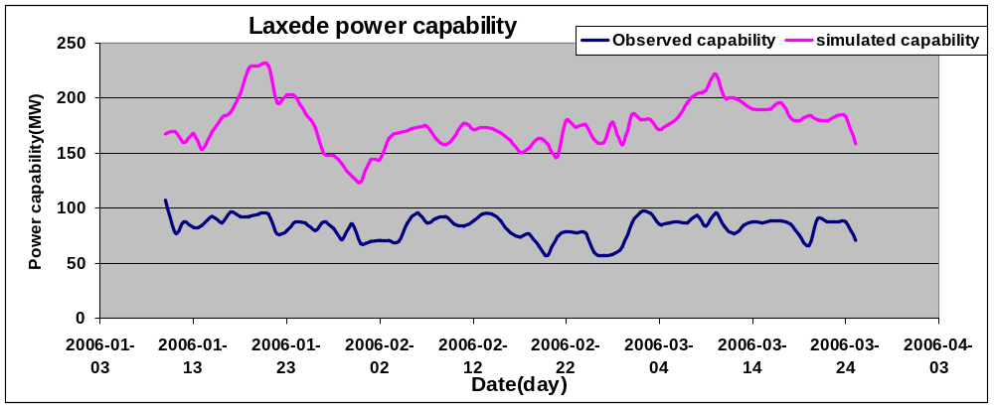
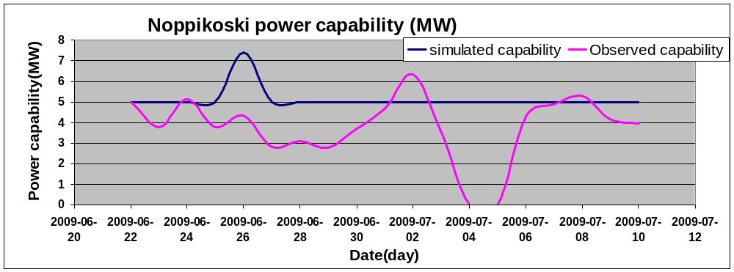
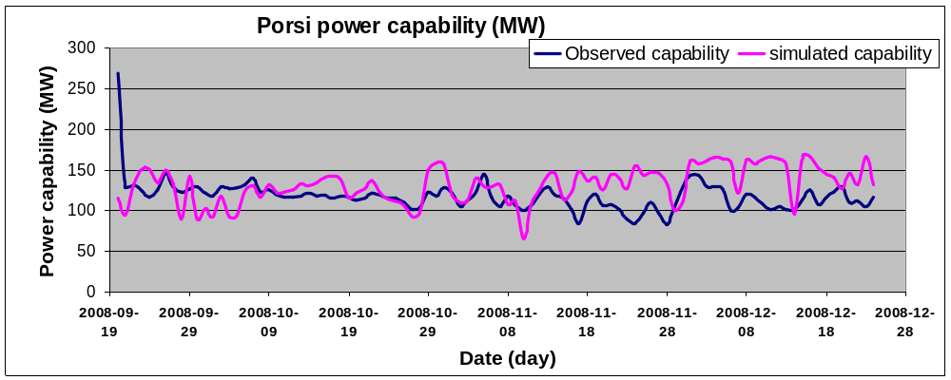
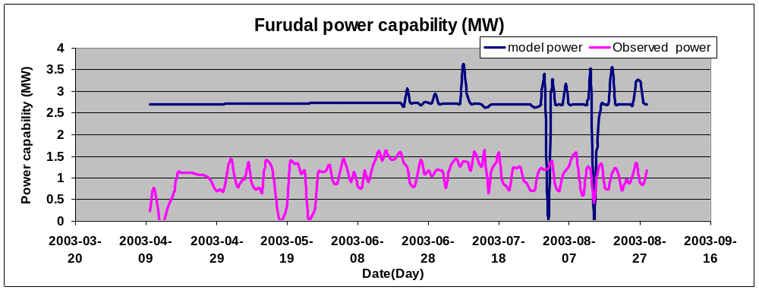
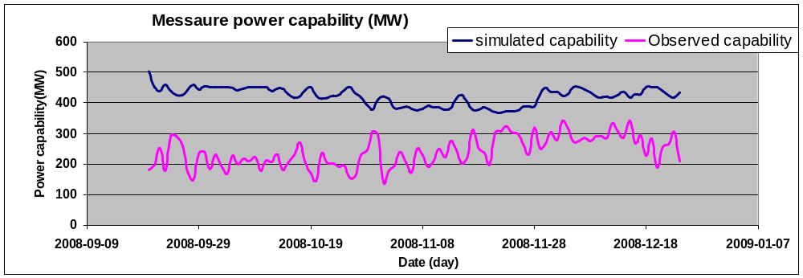
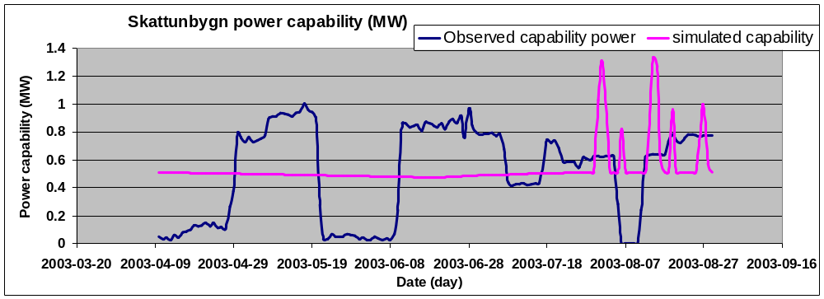
Result
Ore river basin
Capacity factor meliorate to 72% from 41%
Lule river basin
Capacity factor meliorate to 69% from 46%
Realizing sustainable development of hydropower’s projects
Adopting new technologies under environmental and social considerations

