Slide 1

Want to Play a Game?
Sebastian Porling, Aron Hansen Berggren
with inspiration from previous years slides.

Slide 2
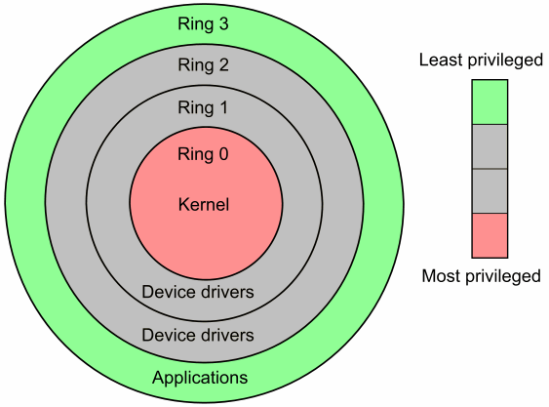
what is a “kernel”?
computer program that is the “core” of the OS
complete control, aka “privilege mode or kernel mode”
makes us not crash computer every hour
handles start-up, drivers etc.

Slide 3

kernel modules
pieces of code that can be loaded and removed without reboot
like drivers and other functionality that requires privilege mode.
think of adding an API instead of an application

Slide 4
character and block devices
Device Driver - a piece of software that operates or controls a particular type of device
Device File - an interface for a device driver that appears in a file system as if it were an ordinary file
Character device - is the one which the Driver communicates by sending and receiving single characters
Block device - is the one which the Driver communicates by sending entire blocks of data

Slide 5
useful commands
lsmod - shows the status of modules in the linux kernel
insmod - inserts a module in to the linux kernel
rmmod - removes a module from the linux kernel
make - to run the Makefile, you can find more info with man make
dmesg - shows all info from kernel buffer

Slide 6
Makefile
a kind of script file used for compiling
keeps track of already compiled files
use tabs not spaces for indentation
uses shell code and dependency

Slide 7
new C stuff
printk() - prints messages to the kernel log. (Log level, KERN_INFO, KERN_ERR etc)
ioctl() - sends requests to a device driver. Like to open a CD-ROM.
Header files:
Consists of macro definitions and function declarations
Uses the .h extension instead of .c
Typically used for collecting macros and functions used by multiple files

Slide 8
EXAM QUESTIONS

Slide 9
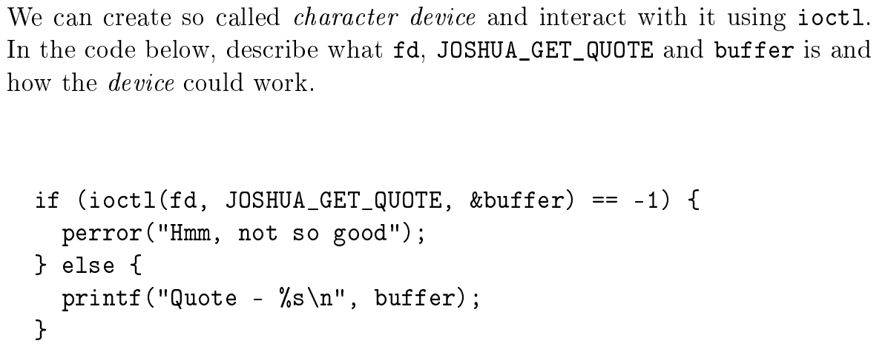
2017-08-21

Slide 10
2017-08-21
Answer:
fd is a file descriptor that we get when we open the file that the module has been registered to.
JOSHUA_GET_QOUTE is an encoded instruction that describes what we wished to do, if we have inputted a buffer, and if it’s to be used for reading or writing.
buffer is a memory area where the module can read or write to.
In this example it’s reasonable to think that we request a quote and that the module will write this to buffer

Slide 11
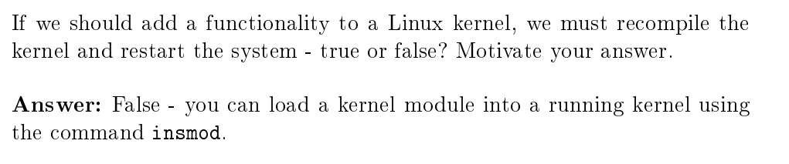
2017-01-14

Slide 12
2017-01-14

Slide 13
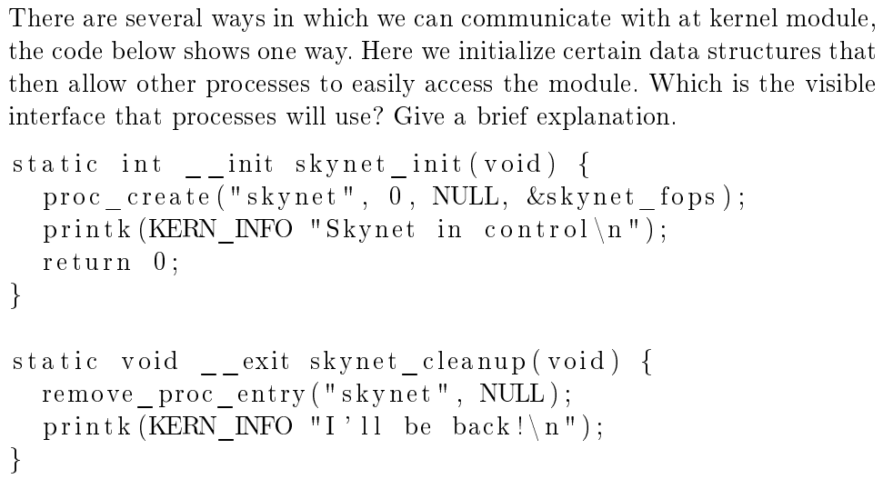
2017-01-14

Slide 14
2017-01-14

