Slide 1

Behavior Trees in 5 Minutes
by Petter Ögren
Notes:
Hello everyone!
In this video I will explain how to create backward chained Behavior Trees.
This is the second lecture in the series ”Introduction to Behavior Trees”.
And my name is Petter Ögren

Slide 2
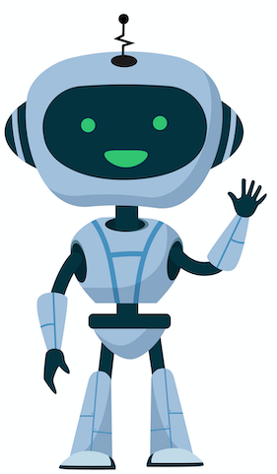

What to do next?
Grasp
Recharge
Drop
Lock
Walk
Unlock
Open
Pull
Close
Push
Search
Kick
Clean
Speak
Speak
Record
Run
Throw
Notes:
This abstraction of “Action” → Modularity

Slide 3
What to do next?
Recharge
Lock
Grasp
Speak
Unlock
Pull
Open
Walk
Push
Kick
Drop
Close
Search
Speak
Finite State Machine
Clean
Record
Each action needs to know “What to do next”…
Notes:
256 transitions (49 transitions)

Slide 4
What to do next?
Grasp
Recharge
Drop
Lock
Walk
Unlock
(parent)
Open
Pull
Success,
Failure,
or Running
(tick)
Close
Push
Grasp
Search
Kick
Behavior Tree
Clean
Speak
Each action needs to know “Did I Succeed or Fail?”
Speak
Record
Run
Throw
Ancestors decide “What do to next?”
Notes:
This abstraction of “Action” → Modularity

Slide 5
Two Fundamental Compositions of Actions
Fallback (?)(or)
  (Eat Sandwitch ? Eat Apple)
Sequence (→)(and)
  (Peel Banana → Eat Banana)
IF Failure then Tick Next
else Return “same as child”
IF Success then Tick Next
else Return “same as child”
?
Eat Sandwich
Eat
Apple
Tick (going down)
Success (up)
Running (up)
Failure (up)
→
Peel Banana
Eat Banana

Slide 6
Further BT ideas to explore…
Bye!
Safety Guarantees
Back chaining designs
Decision Tree designs
Swarm Control
Human Robot Interaction
Convergence guarantees
Genetic Programming
Utility BTs
Additional node types (Parallel, Decorators)
BTs and Control Barrier Functions
Designed by pch.vector / Freepik

