Slide 1
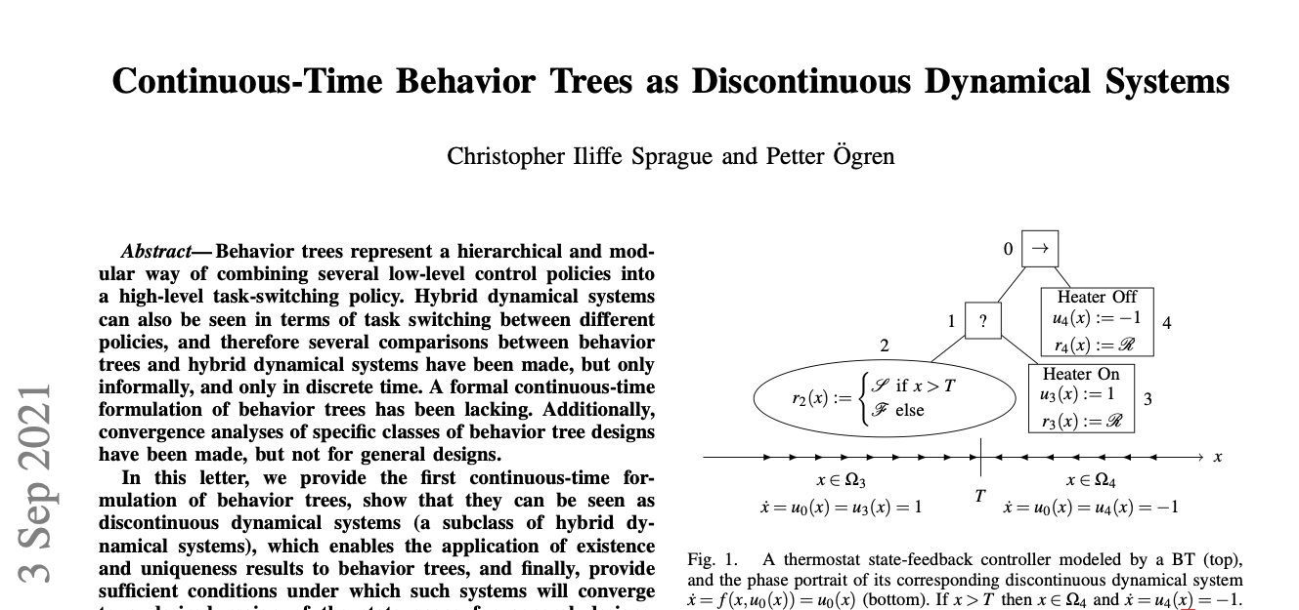
When will a subtree execute? or Analyzing Behavior Trees as Discontinuous Dynamical Systems
An Introduction to Behavior Trees in AI (part 9)
by Petter Ögren
Notes:
Hello everyone!
In this video I will explain how to create backward chained Behavior Trees.
This is the second lecture in the series ”Introduction to Behavior Trees”.
And my name is Petter Ögren

Slide 2
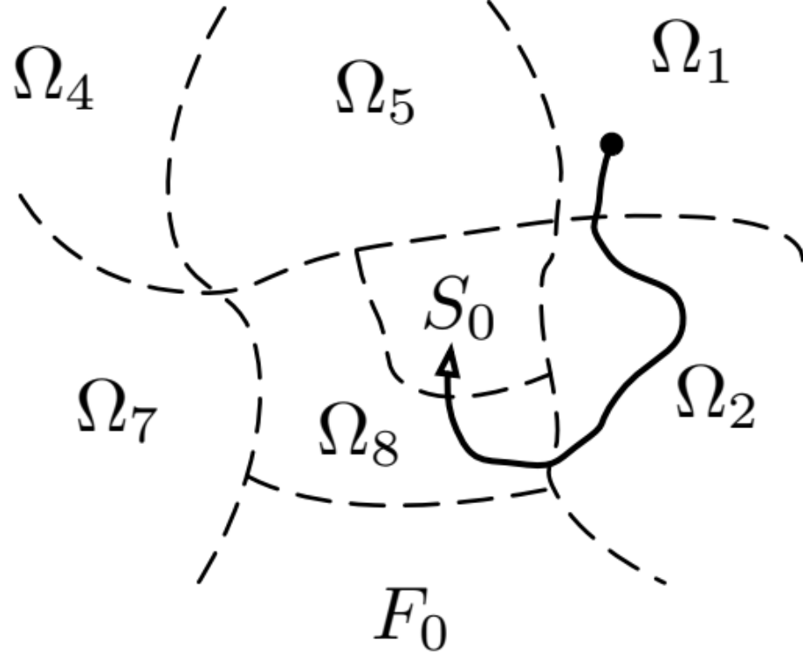
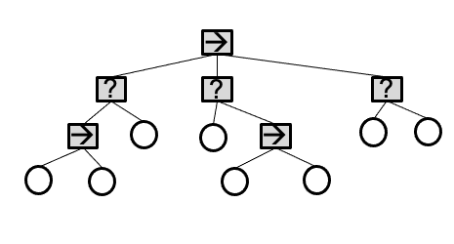
Outline
What is a Discontinuous Dynamical System?
  BT can be seen as a DDS
When will a subtree execute?
  Inside its Operating region Ω_{i}
When will a subtree get ticked?
  Inside its Influence region I_{i}
How do we compute these ?
  recursive formulas…
Can we analyze a BT using the Ω_{i} ?
  yes, goal convergence or infinite cycles can be found…
Can we guarantee existence and uniqueness of solutions?
  yes…

Slide 3

Discontinuous Dynamical System (DDS)
BT can be seen as a DDS
→ analyze using Ω_{i}
x₂
x ₁

Slide 4
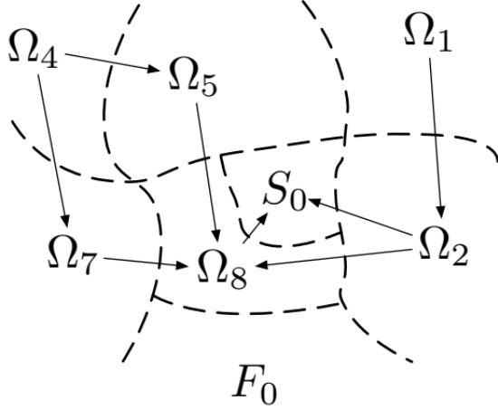
Discontinuous Dynamical System: Convergence
If we only have transitions as shown by arrows (in finite time)…
Then all executions lead to Success (S₀)
How do we compute Ω_{i}?
x₂
x ₁

Slide 5
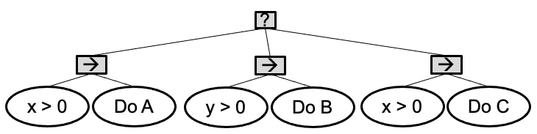
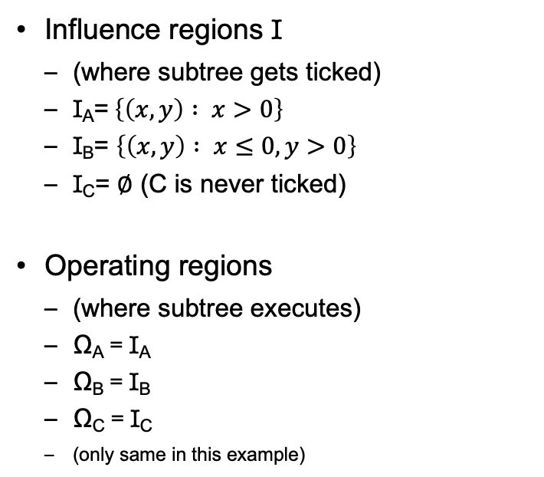
Example: When do leaf nodes of BT execute
y
Influence regions I
  (where subtree gets ticked)
  I_{A}=$\left\{\left(x,y\right) : x>0\right\}$
  I_{B}= $\left\{\left(x,y\right) : x≤0, y>0\right\}$
  I_{C}= $∅$ (C is never ticked)
Operating regions
  (where subtree executes)
  Ω_{A} = I_{A}
  Ω_{B} = I_{B}
  Ω_{C} = I_{C}
  (only same in this example)
I_{B}
I_{A}
x
F₀
  (assume A, B, C always return running)

Slide 6
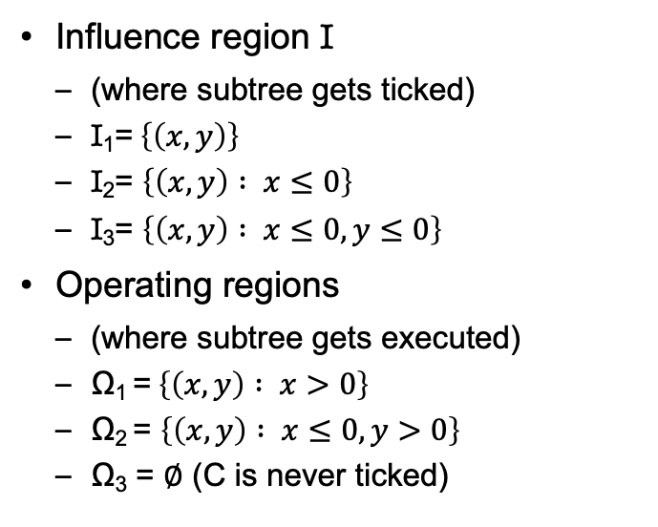
When do subtrees execute?
y
I₂
I₁
Ω₂
Ω₁
Influence region I
  (where subtree gets ticked)
  I₁=$\left\{\left(x,y\right)\right\}$
  I₂= $\left\{\left(x,y\right) : x≤0\right\}$
  I₃= $\left\{\left(x,y\right) : x≤0, y≤0\right\}$
Operating regions
  (where subtree gets executed)
  Ω₁ =$\left\{\left(x,y\right) : x>0\right\}$
  Ω₂ = $\left\{\left(x,y\right) : x≤0, y>0\right\}$
  Ω₃ = $∅$ (C is never ticked)
x
I₃
1
2
3
in general…

Slide 7
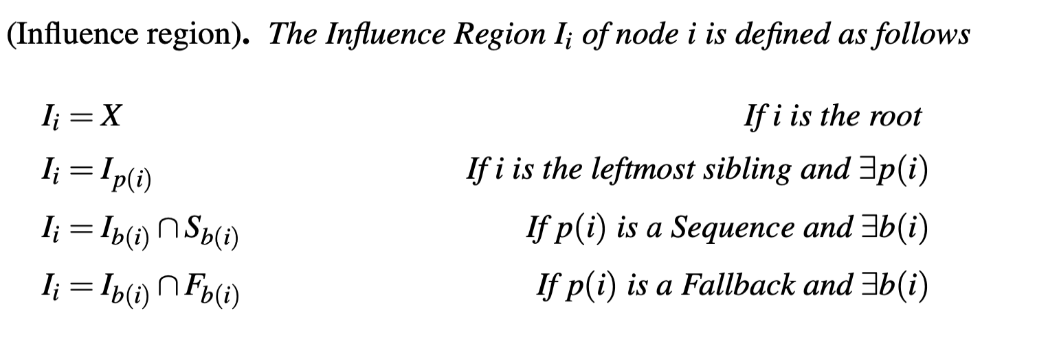
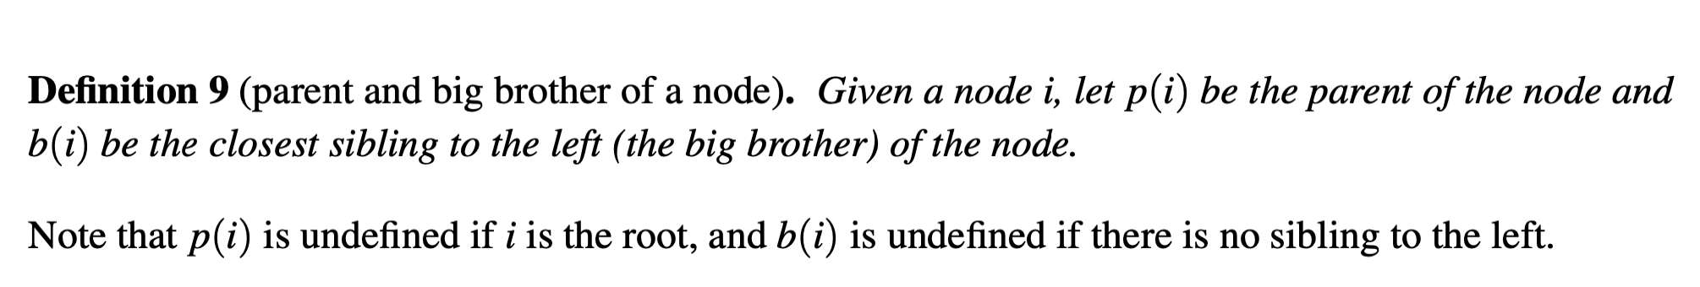
Influence region (general)
y
I₂
I₀=I₁
x
I₃
0
p(i) (parent of i)
b(i) (closest brother to the left of i)
S (success region)
F (failure region)
1
2
3

Slide 8
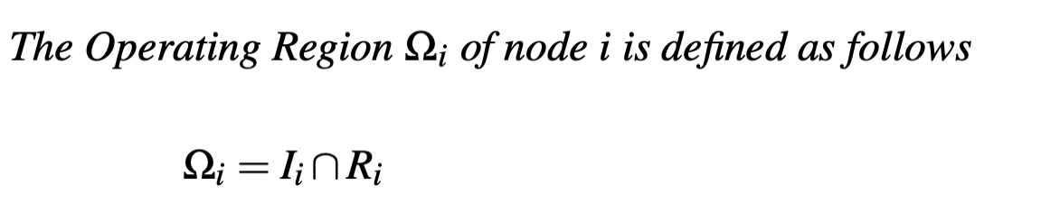
Operating region (general)
y
I₂
I₀=I₁
Ω₂
Ω₁
x
I₃
Only depends on external factors
0
1
2
3
Only depends on internal factors
Depends on both

Slide 9
Discontinuous Dynamical System
If we only have transitions as shown by arrows (in finite time)…
Then all executions lead to Success (S₀)

Slide 10
Pick and place BT (with guarantees)
S₀: Object at goal
Ω₂: Object not at goal, in hand
Ω₃: Object not at goal, not in hand, near agent
Ω₄: Object not at goal, not in hand, not near agent
1
0
?
4
Object at goal
Goto Object
2
3
→
→
Object in hand
Drop object at goal
Near Object
Grasp Object
Notes:
We can do Markov chain analysis if only drop at 10% of attempts

Slide 11
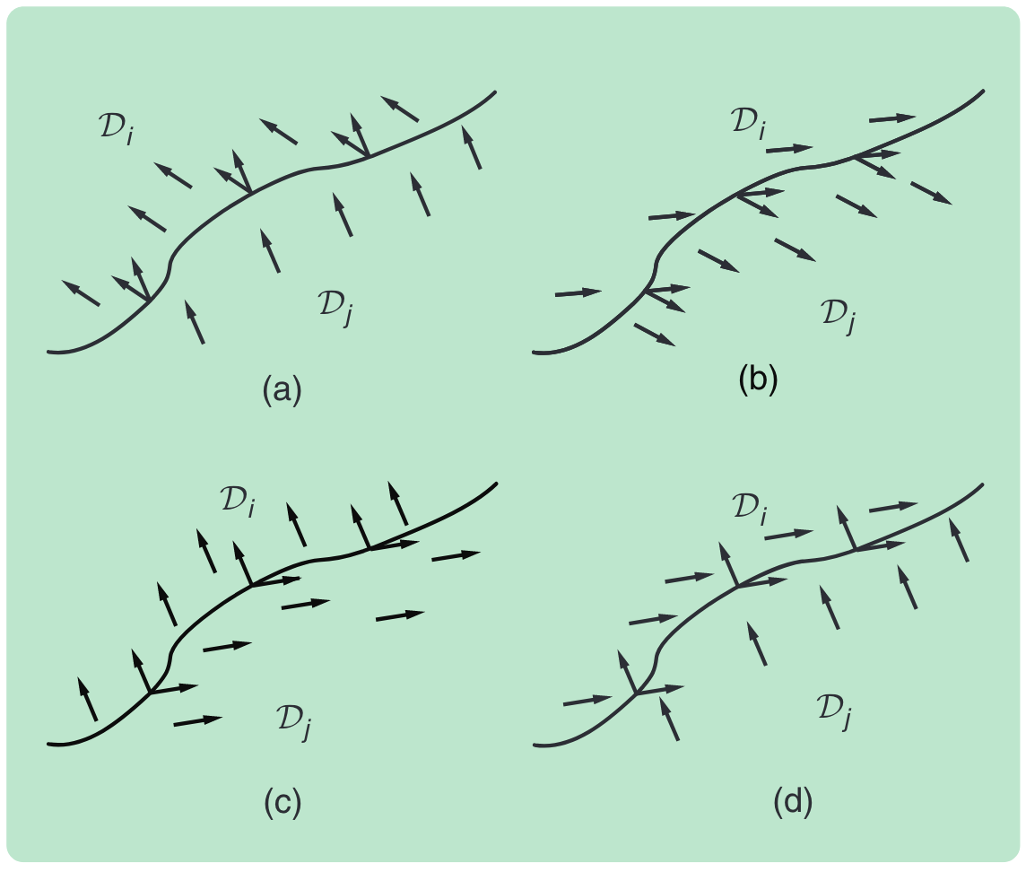
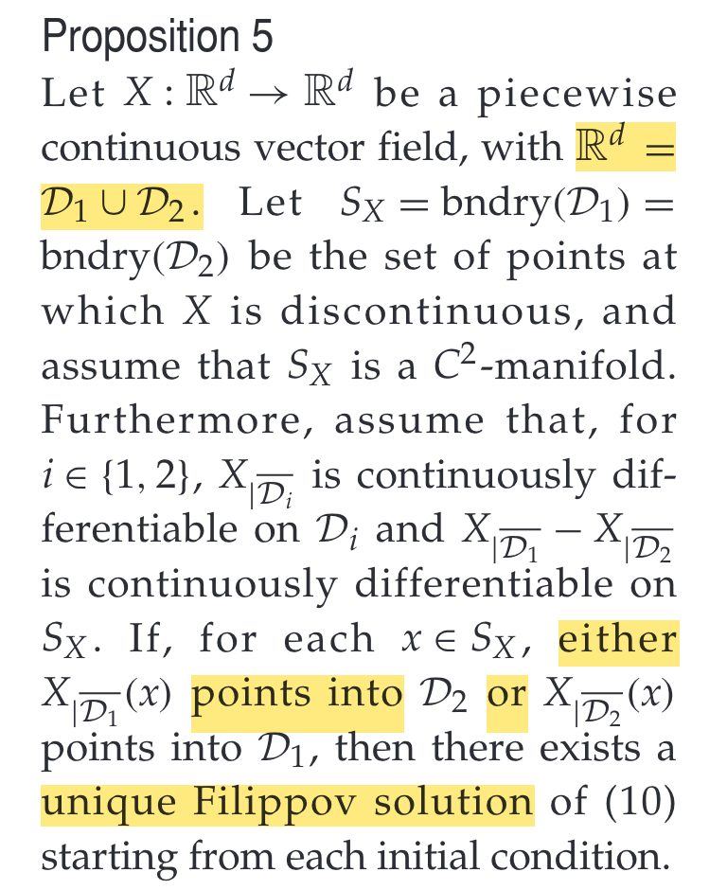
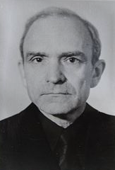
Existence of solutions for DDS
Cortes, J. Discontinuous Dynamical Systems. IEEE Control Systems Magazine 2008, 28 (3), 36–73. https://doi.org/10.1109/MCS.2008.919306.
A.F. Filippov, Differential Equations with Discontinuous Righthand Sides. Norwell, MA: Kluwer, 1988

Slide 12
Example of sliding mode solution
Vector fields point inwards at boundary of Ω_{i}
Sliding mode solution:
  T =T₀
Reversing On/Off gives non unique solution starting at T₀
→
2
1
Heater OFF
?
T > T₀
Heater ON
Ω₁
Ω₂
T
T₀
12

Slide 13
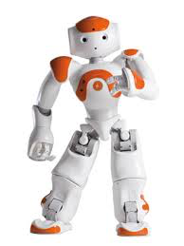

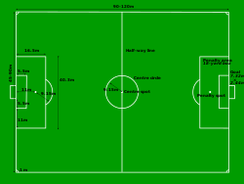

The Infinite Soccer game
→
Play Soccer
?
Battery > 20% and Not Charging
Recharge battery
13

Slide 14
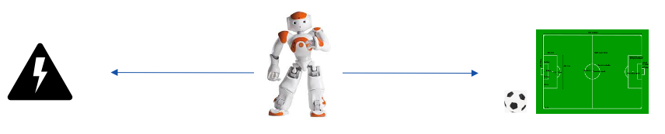

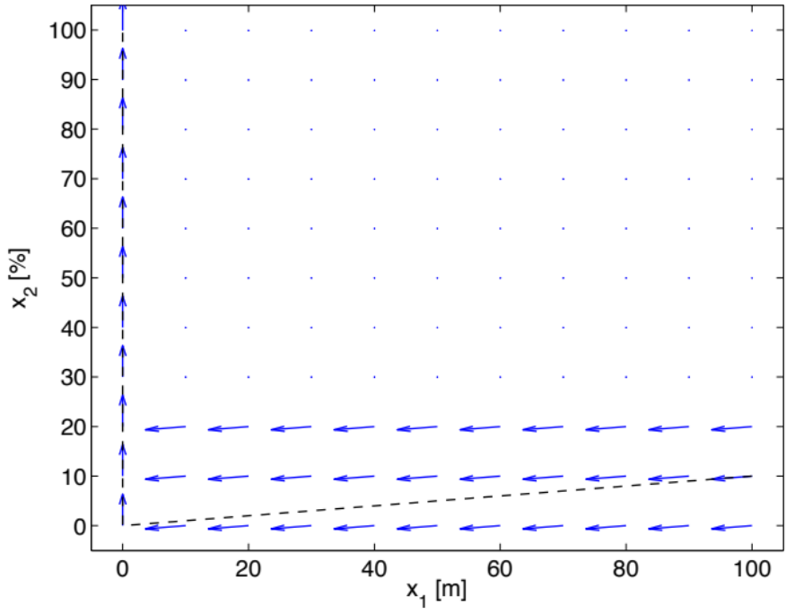
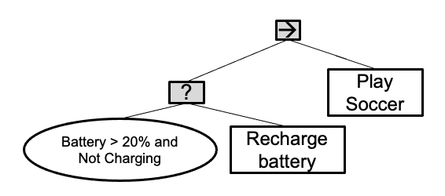

The Infinite Soccer game
S
S
1
F
14

Slide 15
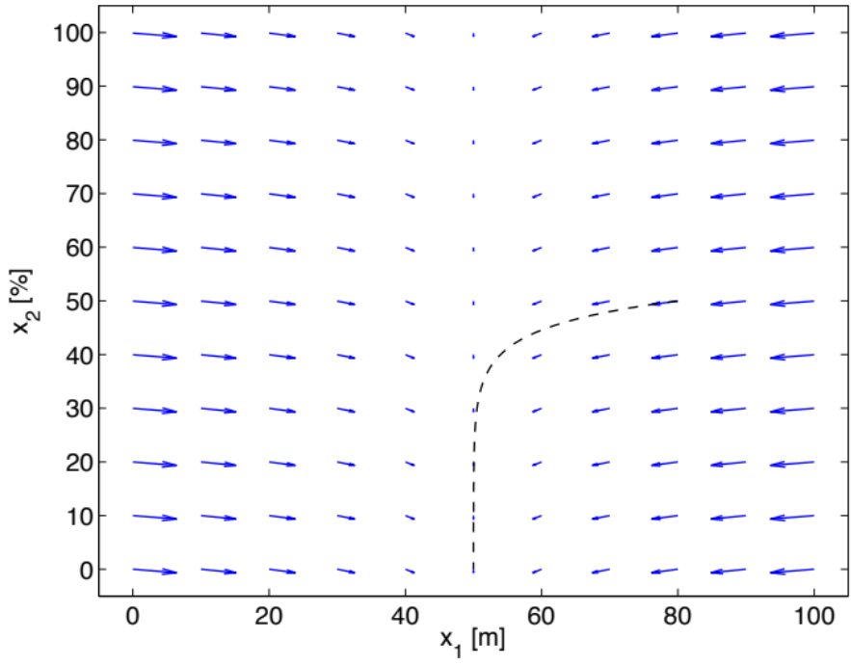
The Infinite Soccer game
2
15

Slide 16
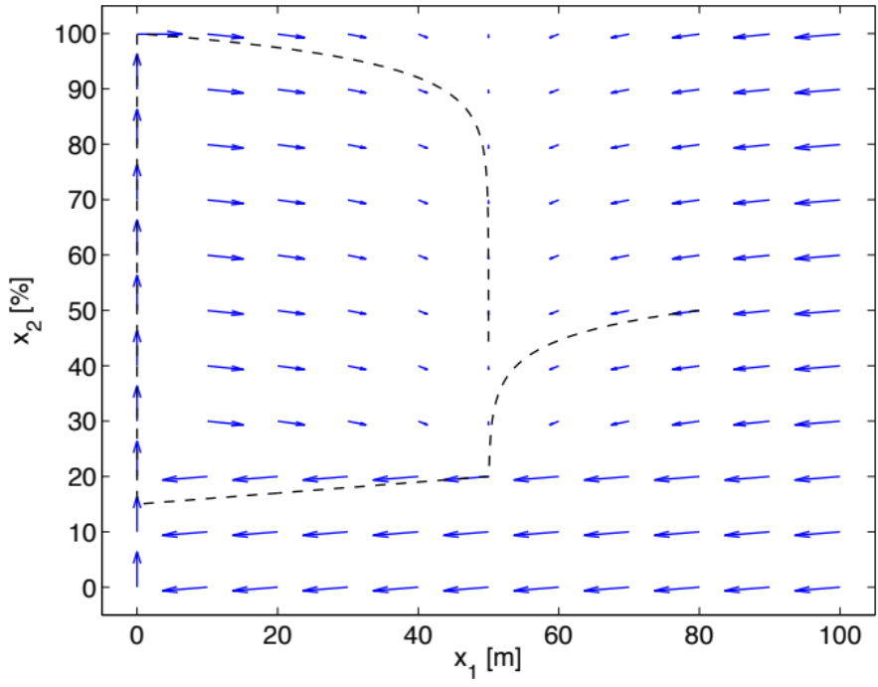
The Infinite Soccer game
Ω₂
We can prove that the battery never runs out (if proper start state)
Ω₁
Ω₂
3
Ω₁
u₁
u₂
F
16

Slide 17
What about Filippov?
Ω₂
Ω₁
Ω₂
Ω₁
Discrete time solutions always exist
Lack of unique continuous time → system sensitive to noise
17
No guarantee of unique solution…

Slide 18
Outline
What is a Discontinuous Dynamical System?
  BT can be seen as a DDS
When will a subtree execute?
  Inside its Operating region Ω_{i}
When will a subtree get ticked?
  Inside its Influence region I_{i}
How do we compute these ?
  recursive formulas…
Can we analyze a BT using the Ω_{i} ?
  yes, goal convergence or infinite cycles can be found…
Can we guarantee existence and uniqueness of solutions?
  yes…

Slide 19
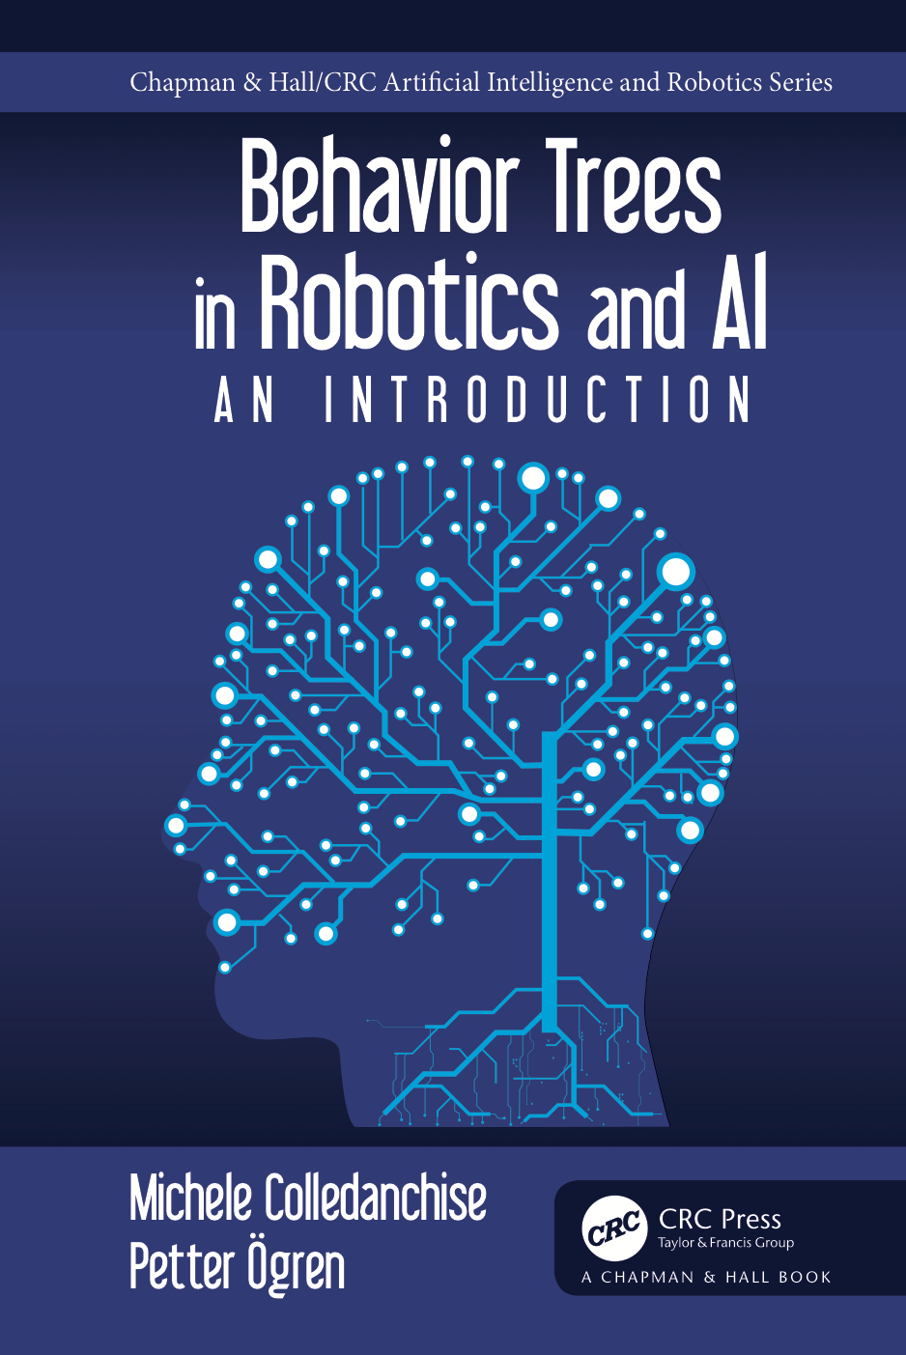
Thank you for watching…
Notes:
We hope we have provided some answers to the questions:
What is a behavior tree?
When are they useful?

